Slide 1
Leveraging DNV and ISO as a Platform for Healthcare Excellence
Consistent, Collaborative, Caring
Quality with a Human Touch
James W. Jeffcoat, MSN, RN-BC

Slide 2
Objectives
Gain insight into DNV Healthcare.
Acquire a high-level understanding of DNV hospital accreditation, credentialing, and certification services.
Be briefed on how ISO 9001:2015 implementation challenges hospitals to improve healthcare quality.

Slide 3
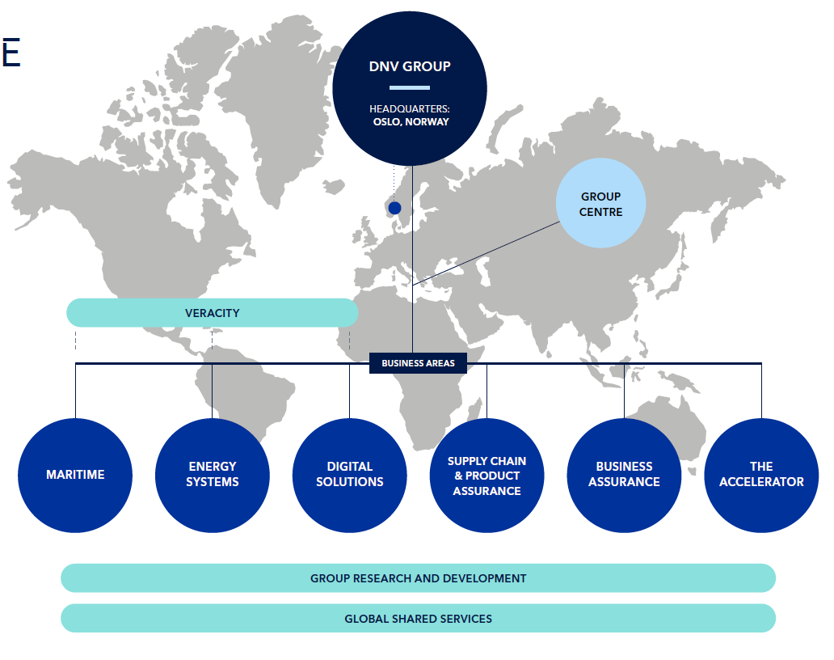
Det Norske Veritas
The Norwegian Truth
One of the world’s leading certification bodies helping businesses
  Manage risk
  Assure the performance of
    Organizations
    Products
    People
    Facilities
    Supply chains through
    Certification
    Verification
    Assessment
    Training services
OUR PURPOSE
OUR VISION
OUR VALUES
To safeguard life,
property, and the
environment.
A trusted voice to tackle global transformations.
We care. We dare. We share.
Notes:
Maureen: DNV is a global organization focused on delivering value to its clients by providing an external organization evaluation of risk and operations that verifies compliance with accepted standards of practice.

Slide 4
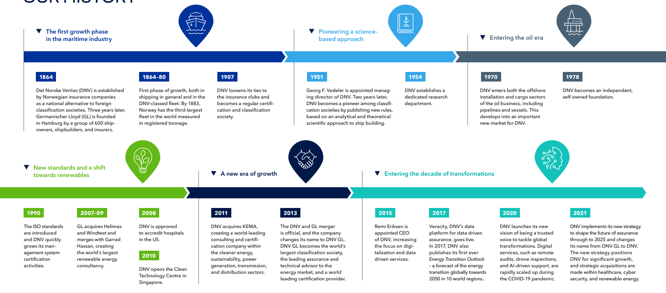
Our History

Slide 5




A global assurance and risk management company
                156
years
                13,000
employees
                100,000
customers
                117+
nationalities
                5% R&D
of annual revenue
Ship and offshore
classification and advisory
Energy advisory, certification, verification and monitoring
Software and
digital solutions
Management system certification,
supply chain and
product assurance
Notes:
Our global reach and density of offices around the world is another factor that enables us to take a broader view. Our 12,000 employees are operating in more than 100 countries (we have 350 offices in over 80 countries) and we pride ourselves of having the same high standards where ever you meet us around the world.

Slide 6
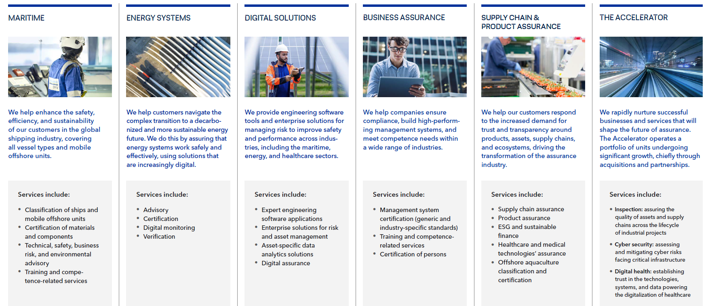
Business Areas at a Glance

Slide 7

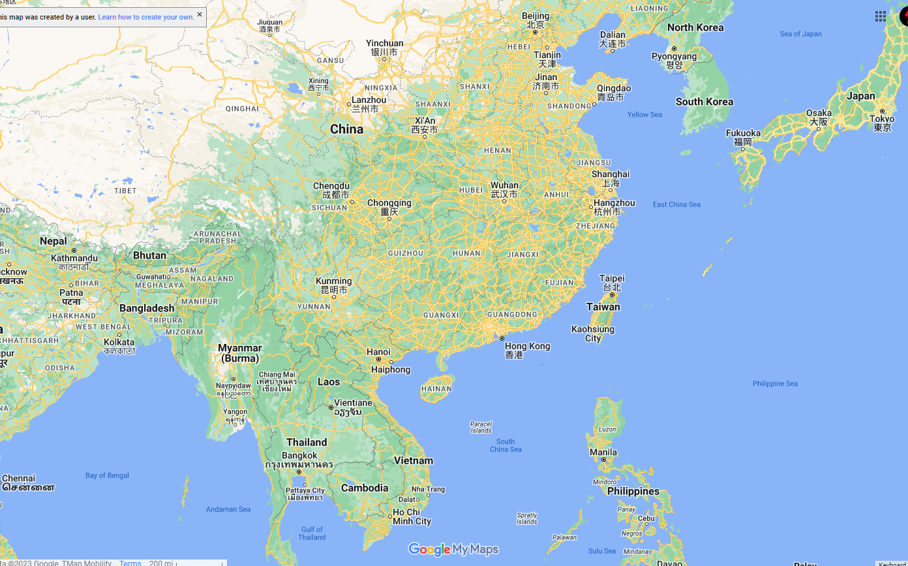
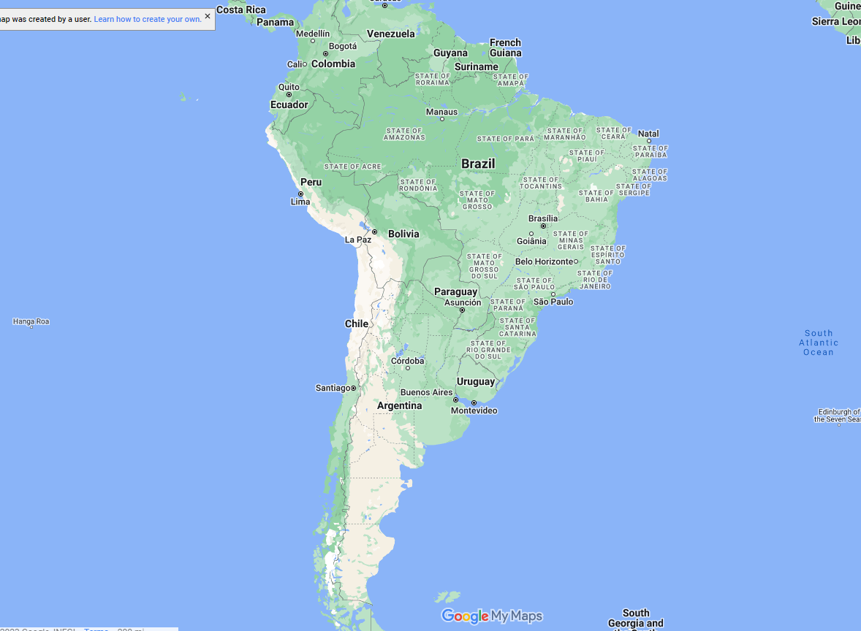
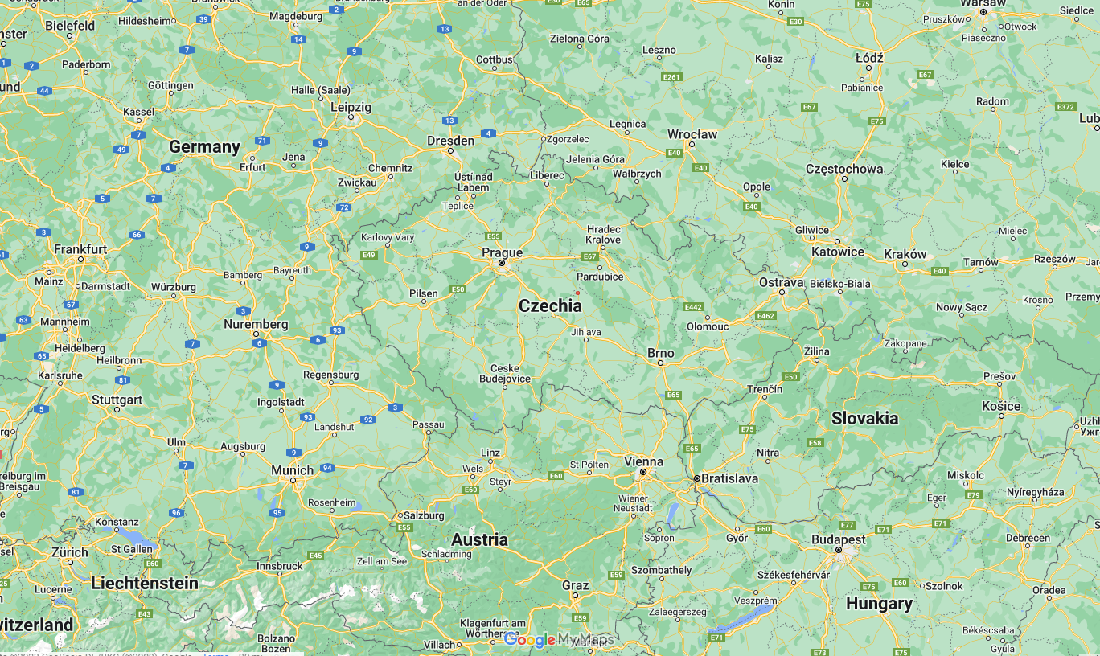
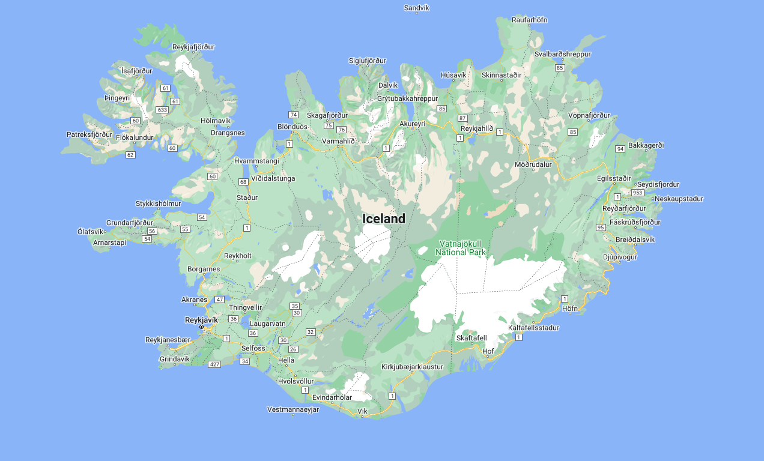
DNV Healthcare
Accreditation Sites
  286 system-based hospitals
  501 independent hospitals
  4 China
  6 Brazil
  1 Iceland
  1 Slovenia
  1 Czech Republic
  2 Thailand

Slide 8
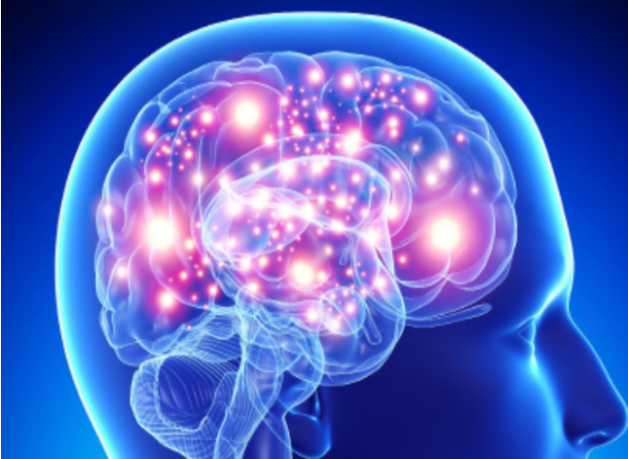
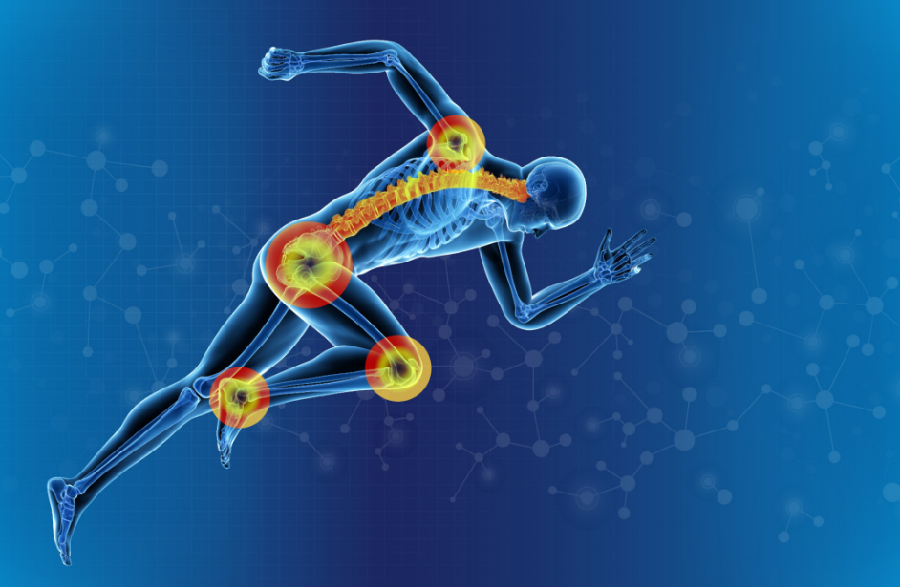
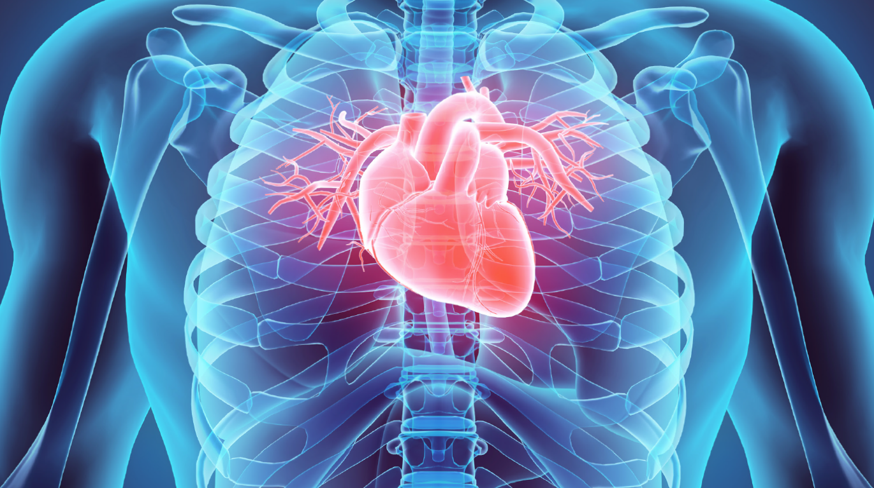
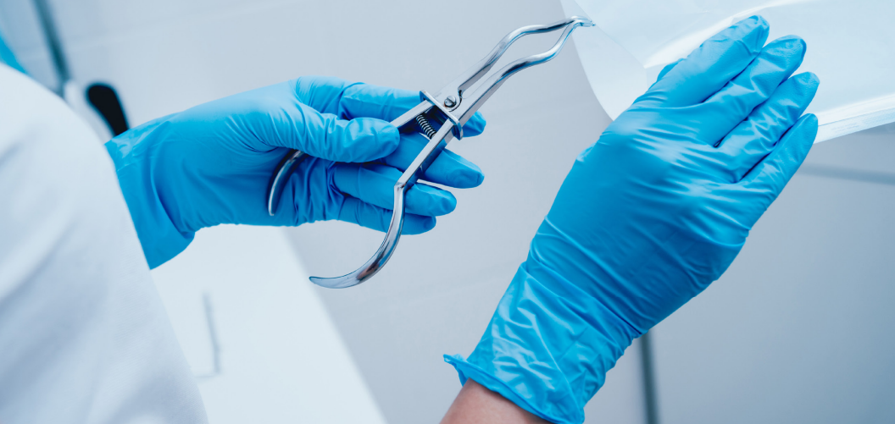
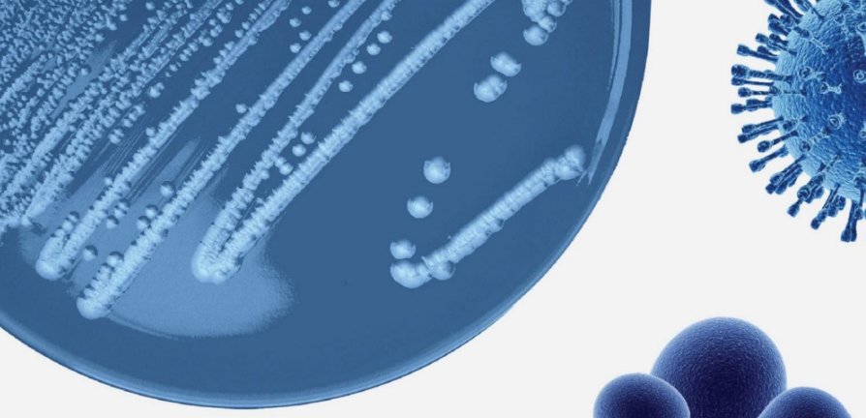
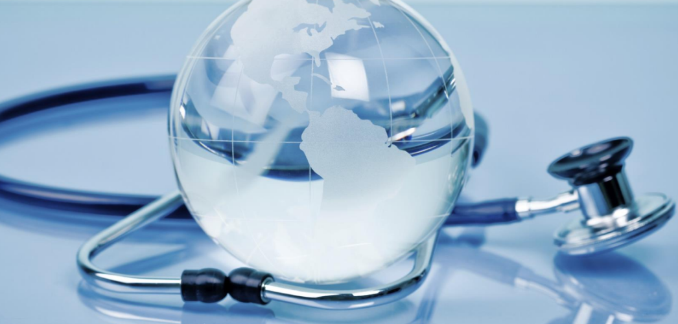
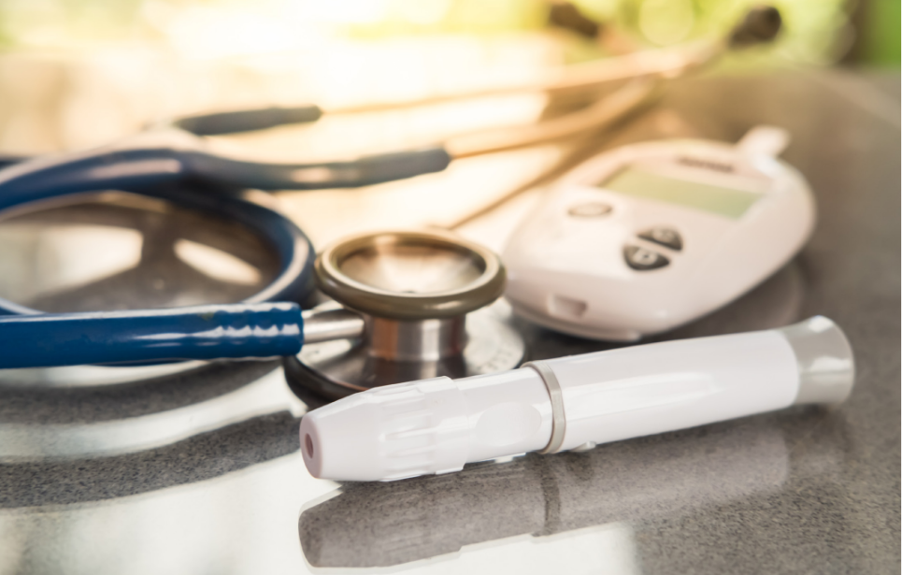

DNV Healthcare
Certifications
  Stroke
    4 Platforms
  Orthopaedic
    4 Platforms
  Cardiac
    4 Platforms
  Sterile Processing
  Infection Prevention
  Palliative Care
  Glycemic Management
  Collaborative High Reliability

Slide 9


The “Why” of Quality
1 in 31 hospital patients has at least one healthcare-associated infection (CDC, Nov. 2022)
https://www.cdc.gov/hai/data/portal/index.html
200,000 people die every year from hospital errors, injuries, accidents, and infections
1 in 4 chance of experiencing injury, harm or death when admitted to a hospital
Today alone, >1000 people will die because of a preventable hospital error
https://www.hospitalsafetygrade.org/errors-injuries-accidents-infections

Slide 10
Safety doesn’t happen by accident.
                ~Author unknown

Slide 11
Every American has a right to affordable, high-quality health care.
~Sen. Max Baucus (MT)

Slide 12
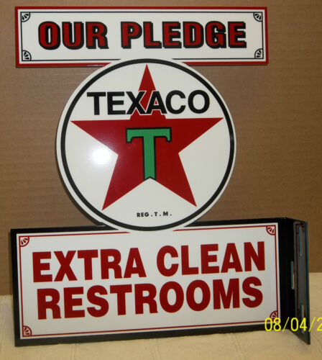

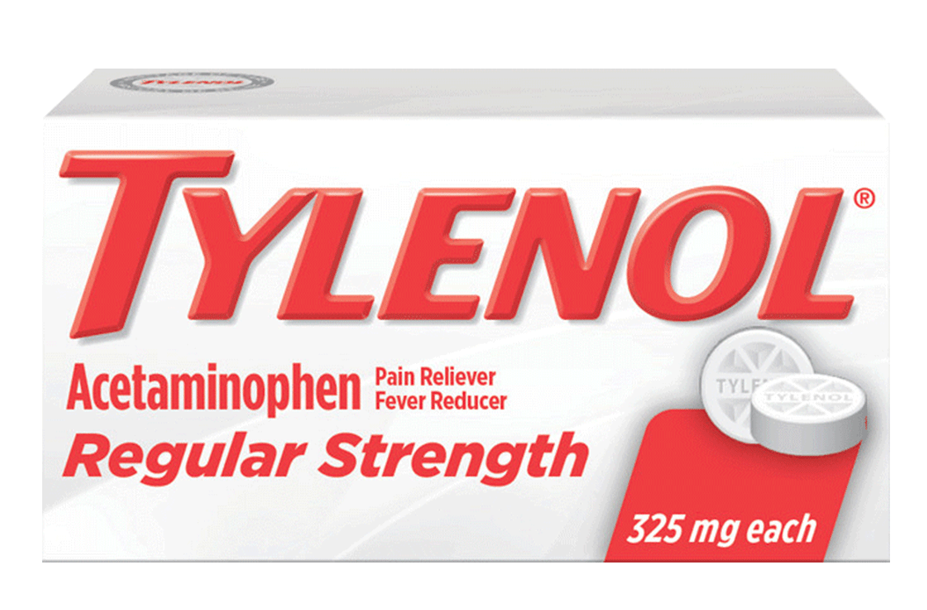
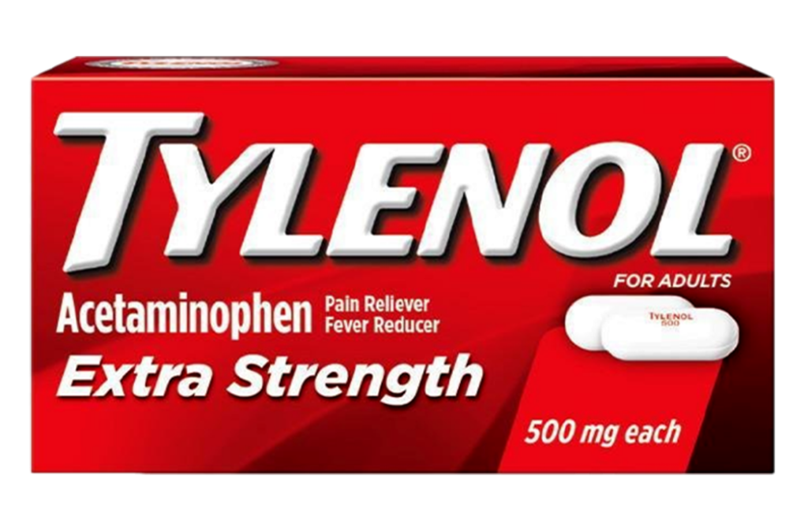
Expectations…
https://www.newschannel10.com/2023/03/27/new-amarillo-convenience-store-market-growing-with-3-new-companys/
https://i.ebayimg.com/images/g/0MsAAOSwDNdVy9nK/s-l500.jpg

Slide 13

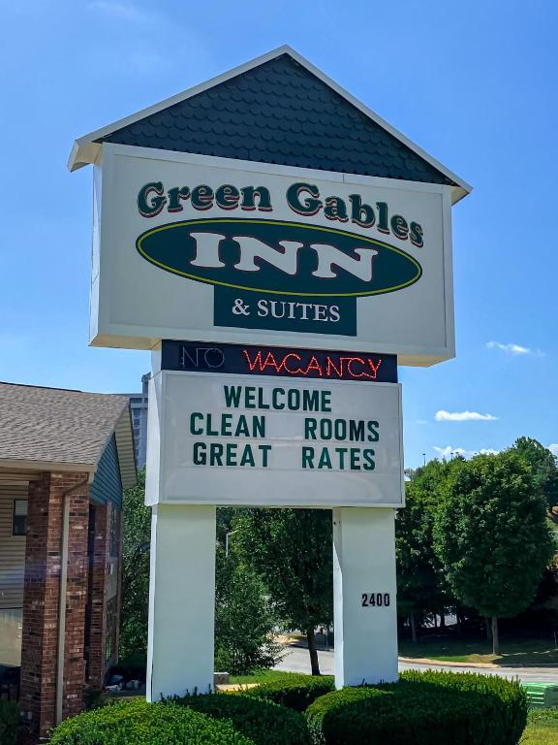
Expectations…
https://www.travelweekly.com/Hotels/El-Paso-TX/Coral-Motel-p58407998
https://planetofhotels.com/en/usa/branson/green-gables-inn

Slide 14

Expectations…
“Clean Rooms”
“Clean Bathrooms”
“High Quality”
“Friendly Staff”
“Qualified Individuals”
“Latest Technological Advances”

Slide 15

Humans typically…
Attempt a great job, always…
Rarely clock-in to do a terrible job…
Follow processes…
Strive to better
  Themselves…
  The processes they’re beholden to…
  Their practice…
Question:
According to whom?

Slide 16
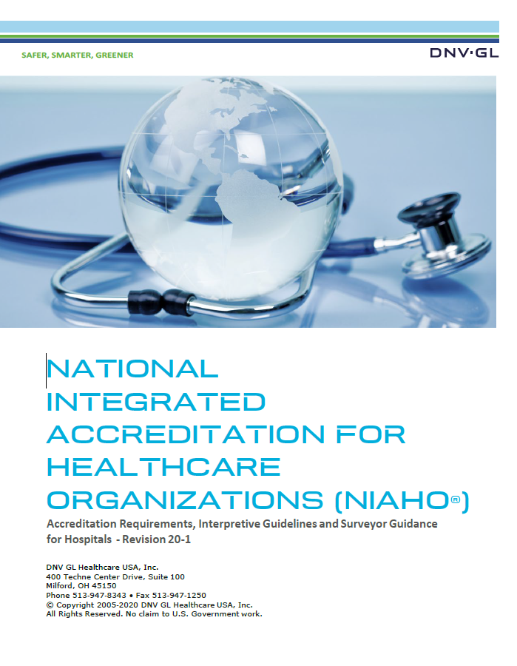
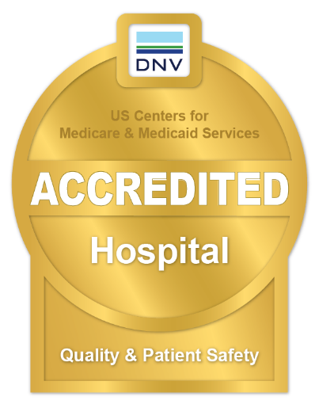
Enter: Requirements
DNV Healthcare hospital requirements
Align with the CMS CoPs
Standardizes the following:
  Quality Management System
  Governing Body
  Medical Staff
  Nursing Services
  Staffing Management
  Surgical, Anesthesia, Emergency Services
  Medication Management
  Laboratory Services
  Infection Prevention and Control
  Patient Rights

Slide 17
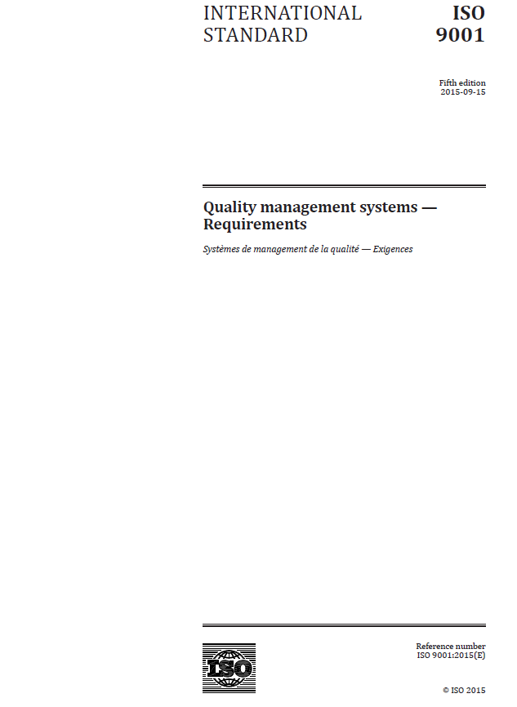
Added Benefit:
A standard that sets out the requirements for a quality management system (QMS)
Used by any organization, including:
  Hospitals
  Banks
  Universities
ISO 9001 benefits
  Increased productivity and efficiency, lowering the costs of an organization.
  Improved customer experience, resulting in repeat business, increased sales and additional income for your business.
  Enhanced reputation, attracting new customers to your organization.

Slide 18

ISO Pillars
Customer Satisfaction
Community
Service Delivery
Trust
High Reliability
Leadership
Planning
Support
Operation
Improvement
Organization
Organizational Context
Performance Evaluation

Slide 19
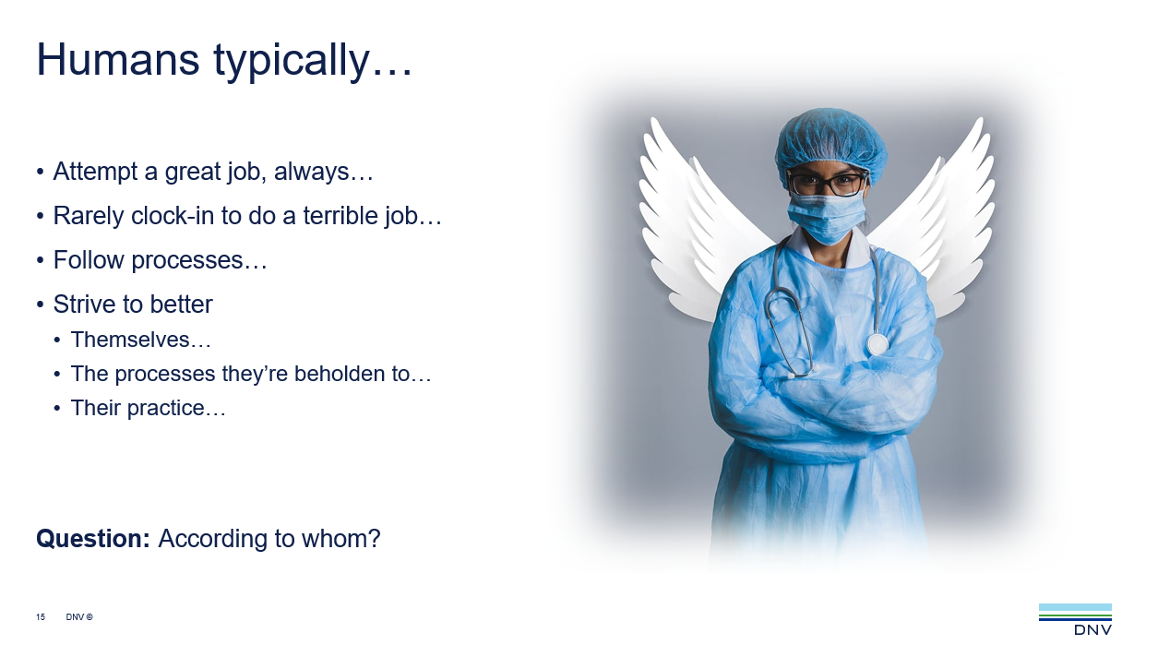
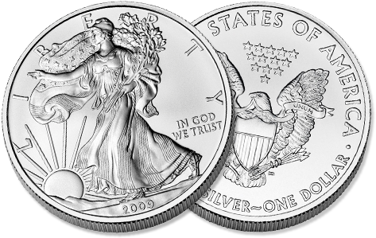
Final Thoughts…
Recall…
CMS Hospital Requirements
  The “have tos” for compliance / reimbursement
ISO Industry Requirements
  The “get tos” to demonstrate high quality
All others we validate

Slide 20

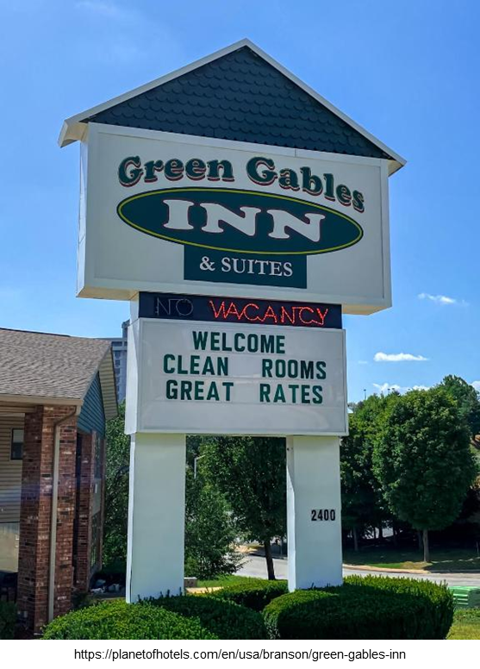


Questions??

Slide 21
Leveraging DNV and ISO as a Platform for Healthcare Excellence
Consistent, Collaborative, Caring
Quality with a Human Touch
james.jeffcoat@dnv.com

