Slide 1


IDEA Journey
Inclusion, Diversity & Equity for All
Rhonda Jordan, EVP & Chief Human Resources Officer
Jenny Zanetich, VP Talent Management

Slide 2

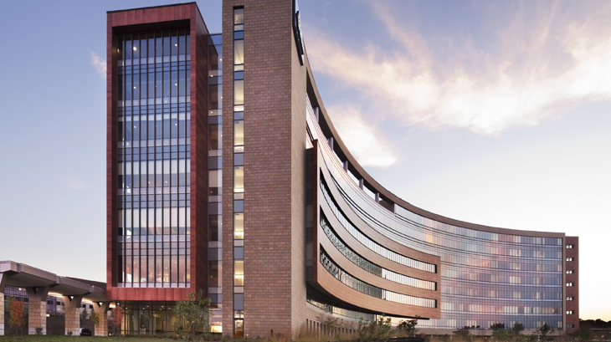
Vision
The trusted choice for personalized
health care and wellness.
Mission
Virtua helps you
be well, get well, and stay well.

Slide 3
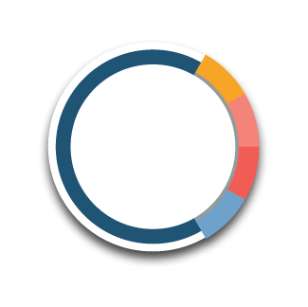
This is Virtua Health
Primary & Specialty Care Practices
Colleagues
Medical Staff Clinicians
Care Locations
14,000+
2,900+
400+
290+
39 Emergency Medical Service Units
35 Ambulatory Surgical Centers
22 Outpatient Labs
20 Physical Therapy/Rehab Centers
15 Cardiac Testing Centers
9 Imaging Centers
7 Emergency Departments (including 2 satellite EDs)
7 Health & Wellness Centers
8 Urgent Care Centers (offering Telehealth)
6 Dialysis Centers
5 Behavioral Health Locations, Inpatient and Outpatient
5 Hospitals
5 Outpatient Heart Failure Centers
5 Vein and Vascular Centers
4 Cardiopulmonary Rehabilitation Centers
4 Centers for Diabetes, Nutrition, and
Wellness Support
4 Sleep Centers
3 Wound Centers
3 Occupational Health Centers
3 Comprehensive Cancer Centers
2 Bariatric Centers
1 Acute Rehab Center
1 Advanced Cardiovascular Center
1 College of Medicine & Life Sciences
medical school
nursing and allied health professionals school
school of translational biomedical engineering and sciences
1 Clinically Integrated Network
1 Dental Center
1 Advanced Gastroenterology Center
1 Home Care Agency
1 Long-Term Acute Care Hospital
1 Midwifery Birth Center
1 Proton Therapy Center
1 School of Nursing
1 Transplant Center
Updated: 04-18-2023

Slide 4
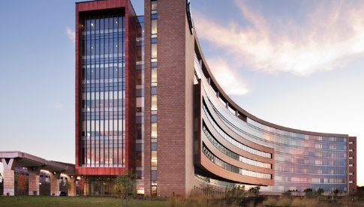
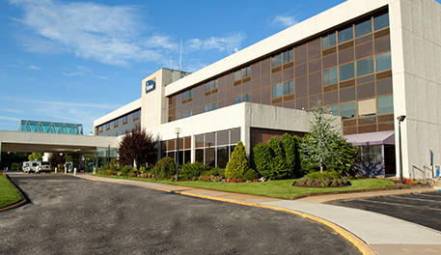
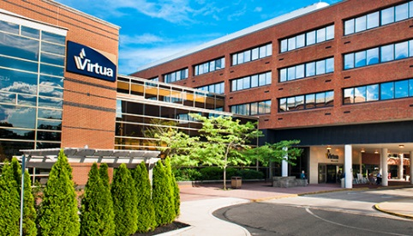
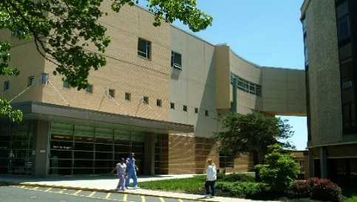
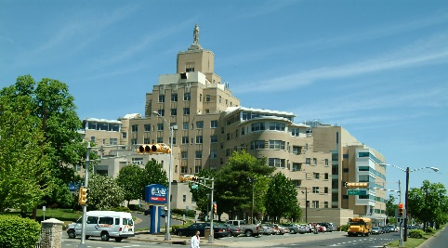
Virtua Voorhees
402 beds
Virtua Marlton
198 beds
Virtua Willingboro
169 beds
Hospitals
1492 beds
Hospitals
Virtua Mount Holly
383 beds
Virtua Our Lady
of Lourdes
340 beds
+
7 Emergency Rooms represent 296,100+ visits.
Satellite
Emergency Departments
Berlin
9,800+ annual visits
Camden
33,600+ annual visits

Slide 5
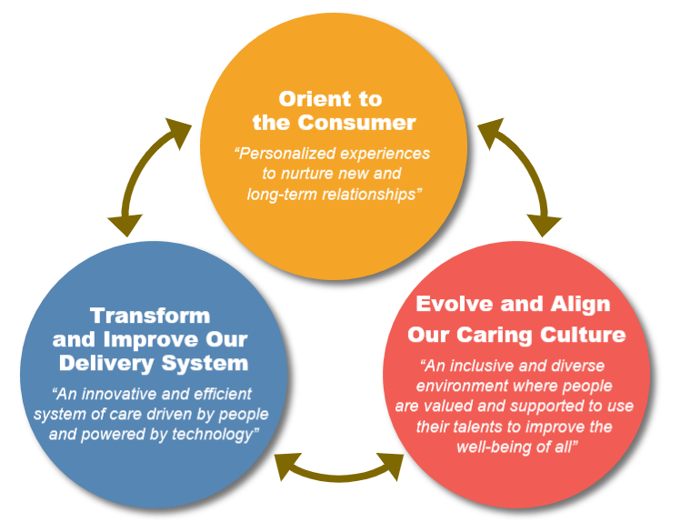
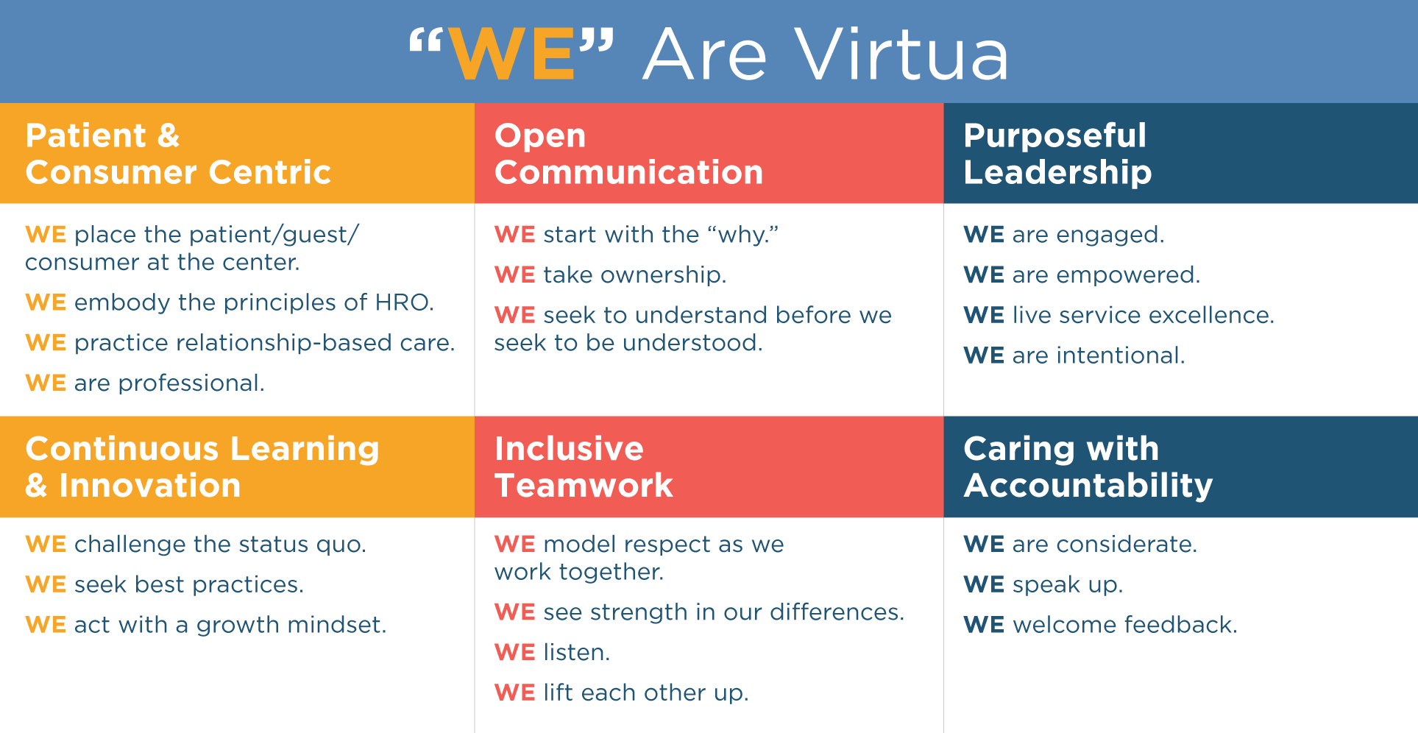
Culture of WE & Strategic Imperatives

Slide 6

Built Upon 3 Pillars
Elevate the Value of Inclusion, Diversity & Equity
Cultivate an Inclusive Culture
Create an Equitable Workplace
Foster a culture and environment of belonging through awareness and education.
Assess and adapt our recruitment & retention practices to support diverse talent.
Define what Inclusion, Diversity & Equity means at Virtua with a clear philosophy and approach.
Notes:
Elevate the Value of I&D:
Define and implement structures/processes to imbed IDEA
Cultivate and inclusive Culture:
Continuous knowledge and skill building through formal organizational competency building and more informal “from the people, by the people” events/experiences via Colleague Communities
Create and Equitable Workplace:
Includes A&R/Celebration, policies, practices to retain and attract talent

Slide 7
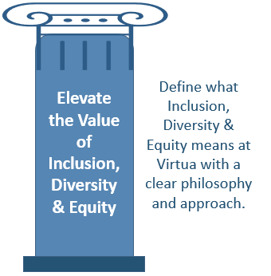
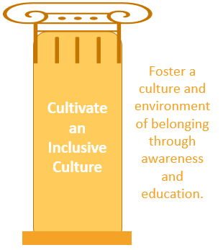
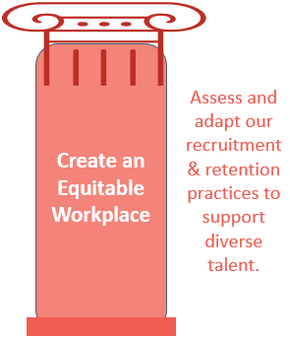
Milestones
2020-2021
2022-2023
Establishment of IDEA Framework via Design Committee
IDEA Steering Committee members selected and first of quarterly meetings conducted
Focus on engagement question: “I feel like I belong”
Behaviors integrated into Annual Performance
Launch of WE Hours
Annual engagement survey measures Diversity Index demonstrating significant year over year improvement
Pronoun selection available on email and signature templates, select badging and within HRIS system (personal profile)
Conducted Continuing the Conversation (Summer 2020)
IDE Executive and Board education completed
2021 organizational-wide Unconscious Bias education completed (100% leaders; 80% colleagues)
Colleague Communities process & groups established: Women of Virtua, Black African American, OUT @ Virtua, and VirtuAsia
2022 executive and organizational-wide Emotional Intelligence education completed
IDEA eLearning “on demand” content and Power of Inclusion webcast made available
Colleague Communities expand to include WE Serve and Gen V
Celebration of, and education on, multi-cultural and ethnic events
Talent Review process evolves; Formal Mentoring Program for emerging diverse talent launched
Hiring @ Virtua education for all hiring managers and panelists; IDEA videos/content on Careers page
Global Diversity Awareness Month celebrated throughout October
Formal Mentoring Program expanded to multi-level cohorts

Slide 8
Case Study:
Identify and develop diverse talent
Baseline Assessment - 2020
Conducted by BCT Partners
  Females of color are underrepresented across the board, but most notably in leadership positions, more than any other category reviewed.
  The representation of racial minority employees in the new hire cohort is 1.5x higher than its current representation, an indication that although diverse talent is being hired, this talent is not being retained.
Press Ganey annual engagement (re: Sense of Belonging)
  Females, 78% of population, scored 9 pts lower than males
  Diverse groups (except for Asian) scored lower than the organizational average
Tactics to Attract & Retain
Evolve Talent Review process to identify emerging diverse talent
Provide new, purposeful development opportunities to actively invest in diverse talent
  Formal Mentoring Program (6-months; assigned pairs; multi-level)
  Leverage external program Leadership Institute for Black Women (6-months, Manager-level)
  Leadership training (IDE for new/new to role; multi-modality sessions; Colleague Community events)
Structured weekly communications focused within IDE and aligned with our Guiding Principles

Slide 9
Impact
Notes:
Add data on comparison to National HC Averages

Slide 10
Impact
Colleague Culture Survey – Diversity Index
Questions | Organizational Score
This organization values employees from different backgrounds. (ORG) | 4.33 (+.07 YOY)
This organization demonstrates a commitment to workforce diversity. (ORG) | 4.32 (+.06 YOY)
All employees have an equal opportunity for promotion regardless of their background. (ORG) | 4.19 (+.11 YOY)
My coworkers value individuals with different backgrounds. (EMP) | 4.30 (+.04 YOY)
The person I report to treats all employees equally regardless of their background. (MGR) | 4.42 (+.04 YOY)
Notes:
I
The Individual Contributor level remains below the organizational scores for all five questions within the Diversity Index.
Except for Asian and Native Hawaiian or Pacific Islander (new in 2022), diverse historical races scored lower than the organizational score in at least four of the five questions.
The lowest scoring question remains equal opportunity to promote within Virtua year over year.
C—scores are significantly below at .05 and .04 for all questions //can delete scores and/or add in National HC Averages for context

Slide 11
Open for Questions
Notes:
Jenny close

