Slide 1
NCQA Credentialing for Credentialing Service Organizations
2023 NJAMSS ANNUAL CONFERENCE
Gerald Stewart, MHA Senior Policy Manager
Lizzie Branton Thomas, MBA Accreditation Manager
All materials © 2023, National Committee for Quality Assurance

Slide 2
Financial relationships disclosures
Gerald Stewart, has no financial relationships to disclose relating to the subject matter of this presentation.
Lizzie Branton Thomas, has no financial relationships to disclose relating to the subject matter of this presentation.
2

Slide 3
Credentialing products and scope
Working with clients and quality improvement
Credentialing (CR) System Controls
Delegation
Discussion

Slide 4
Benefits of NCQA Credentialing Accreditation and Certification
All materials © 2023, National Committee for Quality Assurance

Slide 5




NCQA credentialing products
Accreditation in Utilization Management, Credentialing, and Provider Network
Certification of Credentialing Verification Organizations
Accreditation of Managed Behavioral Healthcare Organizations
Accreditation of Health Plans

Slide 6
Credentialing standards focus areas by products
 | HP | MBHO | UMCRPN | CVO
Internal Quality Improvement Process |  |  | √ | √
Agreement and Collaboration with Clients |  |  | √
Protecting Credentialing Information |  |  | √ | √
Credentialing Policies | √ | √ | √ | √
Credentialing Committee | √ | √ | √
Credentialing Verification | √ | √ | √ | √
Recredentialing Cycle Length | √ | √ | √
Ongoing Monitoring and Intervention | √ | √ | √ | √
Notification to Authorities and Practitioner Appeal Rights | √ | √ | √
Assessment Organizational Providers | √ | √ | √

Slide 7





Credentialing accreditation/certification benefits
Standardized process for evaluating and selecting practitioners to provide care
Improve operational efficiencies
Increase competitiveness
Improve contracting opportunities

Slide 8

Benefits—The automatic credit advantage
Earning NCQA CR Accreditation or CVO Certification can make credentialing organizations valuable business partners of health plans, other organization seeking NCQA Accreditation.
  Business partners can receive automatic credit on key elements during their own Accreditation survey.
DELEGATION
HEALTH PLAN
CR/CVO DELEGATE
AUTOCREDIT

Slide 9
Credentialing Standards
CRA 1-3

Slide 10
CRA 1: Internal quality improvement process
Product: UMCRPN
QI Program Structure
Defined scope of activities
Defined goals and objectives
Analysis of Activities
Evaluation of data and trends
Assessment of opportunities
Assessment of barriers
Assessment of performance
Action and Follow-Up on Opportunities
Process for assessing performance
Implementation of interventions
Follow-up on actions taken
Accreditation of Health Plans

Slide 11
CRA 2: Agreement and collaboration with clients
Product: UMCRPN
Delegation Agreement
Routine Reporting
Cooperating With Client QI Efforts
Medical Record Access
Communication to Practitioners
Submission of Documents for Oversight

Slide 12
CRA 3: Protecting credentialing information
Product: UMCRPN
Confidentiality Policies/Procedures
Statements about confidentiality
Provisions for paper and electronic information
Personnel Management
Detailed information of security roles
Release of information to third parties
Employee orientation
Employee confidentiality agreements
Disposal of confidential credentialing information
Signed confidentiality agreements
Data Recovery and Back-Up
Controls in place for back-ups
Back-up occur at predetermined intervals
Archived data held in a secured location

Slide 13
Credentialing Standards
CR 1-5: Overview

Slide 14
Credentialing Guidelines
Credentialing Policies and Procedures
Practitioners within Scope
Verification Sources
Credentialing Criteria
Credentialing Decision Process
Decision Notification
Documentation Process

Slide 15
Practitioners within scope of credentialing
Practitioners who have an independent relationship with the organization or its clients, and
Practitioners who provide care to members under the organization’s or its clients’ medical or nonmedical benefits.
Practitioners who are licensed, certified or registered by the state to practice independently (without direction or supervision), and

Slide 16
Verification sources of credentialing information
Primary Source
The entity that originally conferred or issued a credential.
NCQA-recognized/listed source
Contracted Agent of Primary Source/an NCQA-recognized source
The organization obtains documentation indicating a contractual relationship

Slide 17
Verification sources of credentialing information
Product: UMCRPN
Credentials | Source | Verification Time limit*
Licensure | Licensing agency | 180 calendar days
DEA/CDS Certificates | DEA or CDS agency AMA/AOA Masterfile Original or copy Pharmaceutical licensing agency | Prior to the decision
Education and Training | Training institution Specialty board Licensing agency Registry | Prior to the decision
Board Certification | ABMS/AOA of its member boards Other US boards | 180 calendar days

Slide 18
Verification sources of credentialing information
Product: UMCRPN
Credentials | Source | Verification Time limit*
Work History | Application CV | 365 calendar days
Malpractice History | Malpractice carrier NPDB | 180 calendar days
Sanctions and limitations on licensure | Licensing agency State Board of Examiners FSMB | 180 calendar days
Medicare/Medicaid sanctions | State Medicaid agency OIG Exclusion List NPDB FSMB AMA Physician Master File | 180 calendar days
Application and Attestation | Practitioner | 365 calendar days

Slide 19
Collecting credentialing Information from sources
Staff
Third-party software/platform
Web crawler
Delegate

Slide 20
Methods for documenting verifications
Official documents from source
Signed (or initialed) by verifier
Dated by the verifier
A checklist that includes for each verification
Source used
Date of verification
A checklist for all verifications that include
A single signature and a date
For each verification, source used
Signature or initials of verifier
a statement confirming the signatory verified all of the credentials on that date
Report date, if applicable
Report date, if applicable

Slide 21
Practitioner rights
Correct erroneous information.
Receive the status of their credentialing or recredentialing application, upon request.
Review information submitted to support their credentialing application.
To know if information obtained during the organization's credentialing process varies substantially from the information they provided to the organization.

Slide 22

Credentialing criteria
Designed to assess a practitioner's ability to deliver care!
Clean files meet the organization’s criteria for participation

Slide 23
Credentialing decision process
A peer-review process
Credentialing Committee
Medical Director/equally qualified practitioner
Can review clean files only
Consists of types of practitioner in the network
Reviews files that do not meet criteria and consider thoughtfully
Can review clean file review
Evidence that file is clean
Evidence of review and approval
Can be a listing all credentials for all practitioners

Slide 24
Time limit for current license to practice
Example
180 Calendar Days
  Organization verifies license on 7/1/22
  File is presented to committee on 1/2/23
  NCQA counts backward from 1/2/23 – committee decision date – to determine if the 180-calendar day limit is met
  Elapsed time: 185 days
Timeliness requirement not met…
Information presented to
Credentialing Committee >180 days old

Slide 25
Recredentialing cycle length
  The length of the recredentialing cycle is within the required 36-month time frame.
  NCQA counts the 36-month cycle to the month, not to the day.
  Does the following meet the requirement?
    Initially credentialed 6/5/19
    Recredentialed 6/29/22
    Initially credentialed 3/31/19
    Recredentialed 4/1/22
✓
✗
Credentialing Files and Records

Slide 26
Ongoing monitoring and interventions
Implement Actions
Medicare and Medicaid sanctions
Complaints
Adverse events
Sanctions and limitations on licensure

Slide 27
Credentialing System Controls

Slide 28

Intent of CR system controls
  The organization to prevent unauthorized access, changes to and release of credentialing information.

Slide 29

Data in scope of CR system control
All CR information created and used in the CR process (CR 2 –CR 5)
Application and attestation
Verification information
  License
  DEA/CDS certification
  Education and training
  Board certification status
  Malpractice history
  Sanction information
  Etc.
Documentation
  Activity dates (e.g., verification, report, decision dates)
  Verifier/reviewer (initials/signature)
  Reports
  Minutes
  Official credentials/checklist data
  Etc.

Slide 30
CR system controls polices and procedures
Requirements | Applies to
How verification information is received, dated and stored. | verification source information from credentialing and recredentialing cycles, covered in CR 3, Elements A–C.
The tracking and dating of modifications made from its initial verification—when, how, who and why. | modified credentialing verification information from initial credentialing and recredentialing cycles, covered in CR 3, Elements A–C.
Titles or roles of staff who are authorized to review, modify and delete information, and circumstances when modification or deletion is appropriate. | all information associated with credentialing/recredentialing of practitioners, covered in CR 2–CR 5.
The security controls in place to protect the information from unauthorized modification. | all information associated with credentialing/recredentialing of practitioners, covered in CR 2–CR 5.
The building security that adequately limits physical access to credentials information. | physical building.
How the organization monitors its compliance with the policies and procedures in factors 1–4 at least annually and takes appropriate action when applicable. | monitoring process that covers compliance with all policies and procedures described in factors 1–4.

Slide 31
What is a modification?
Any change to the original information recorded in the system.
Correcting typos/mistakes.
﻿﻿Deleting entered information.
﻿﻿Changing receipt and notification dates.
Changing dates in open or closed cases.
﻿﻿Changing practitioner's information that was already entered into the system.
Creating a new record in place of an existing record.
Some types
Correcting typos/mistakes.
Deleting entered information.
Changing dates.
Creating a new record in place of an existing record.

Slide 32
Protecting data from unauthorized modification
Physical Access
Electronic Access
Password management
User access rights
Changes & Release
Internal rights
Building security
Operating environment
External threats
System functionality
Specific policies
Trainings
Proactive monitoring

Slide 33

CR system controls monitoring process
Monitor against system control policies and procedures
  Specify staff titles or roles responsible for oversight of the monitoring process
  Determine monitoring methodology based on system functionality
  Determine monitoring frequency
Identify and analysis modifications that do not meet established policies and procedures
Act on negative findings
Implementing a quarterly monitoring until improvement in one finding over three consecutive quarters.

Slide 34
Advanced System Capabilities
System must have both capabilities
Automatically record dates | Prevent changes that do not meet the organization’s policies and procedures
Documentation Required
Description under monitoring factor 4
How the functionality of the system relative to the requirements compliance with established policies factors 1-4 and 6 (CR 1, Element C, CVO 3, Element B
Benefits
Do not have to provide monitoring and analysis reports in CR 1, Element D.

Slide 35
Monitoring Methods and Sampling
System can identify noncompliant modifications | System can identify modifications but not noncompliant modifications | Systems cannot identify modifications
Review all records with noncompliant modifications | Sample from the entire universe of modifications | Sample from all in the entire universe.
Sampling is not allowed | Calculate the sample size from universe using the 5% or 50 files, whichever is less, methodology | Calculate the sample size from universe using the 5% or 50 files, whichever is less, methodology
 | Review the files in the sample for noncompliant modifications | Continue sampling from the universe and reviewing files until 5% or 50 files with modifications are identified or the all files within the universe have been reviewed.

Slide 36
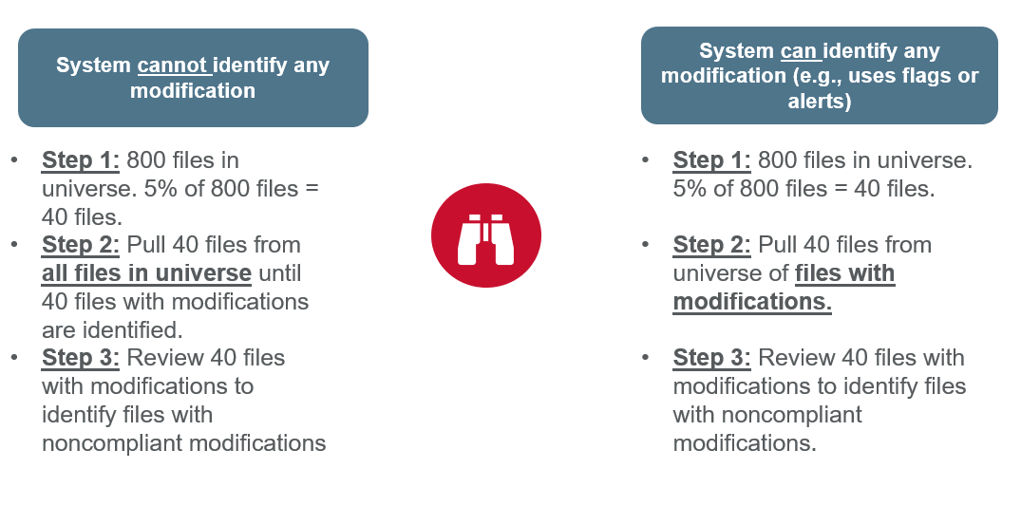
Sampling Methodology—CR 1, Element D: Examples

Slide 37
System Controls Oversight: Monitoring Reports
NCQA is not prescriptive. The following serves as guidance only.
Measurement
Analysis
Quantitative
Improvement Actions
List opportunities for improvement
Frequency
Measurement period
Methodology
File universe
System capability
What is being measured
Sample size
Sample iterations
Title & Report date
Purpose
Numerical findings
Goal (not required)
Qualitative/Causal
Summarize numerical findings relative to unauthorized modifications and goals, if any
Identify role/title of staff involved
Identify the underlying reason for or cause of negative results
Draw conclusion about the results
List actions planned and taken to address opportunities
Implement quarterly monitoring to assess effectiveness of actions
Assessment of effectiveness
Show improvement in one finding for three consecutive quarters

Slide 38
Delegation Oversight

Slide 39
Delegation constraints for CR and CVOs
NCQA-Accredited CR Organizations
  Cannot delegate more than 50% of primary source verifications.
  Cannot delegate more than 50% of credentialing decisions.
  Cannot delegate more than 50% of organizational provider assessments.
  NCQA-Certified CVOs
  Cannot delegate more than 50% of the practitioners the CVO is contracted to provide credentialing activities for.

Slide 40
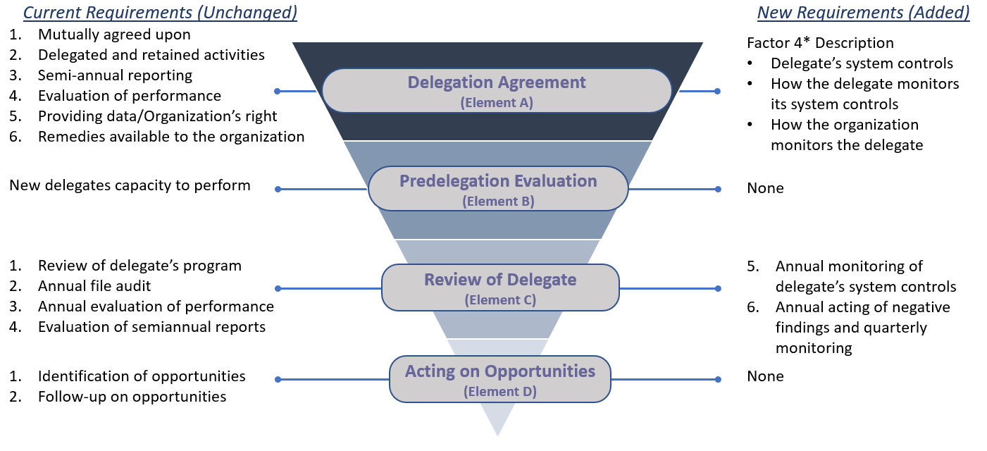
Delegation: What has and had not changed?
*Policies and procedures are acceptable (until July 1, 2024) in lieu of the delegate agreement for agreements implemented before January 1, 2022.

Slide 41
Delegation oversight for system controls—Scope
Delegates | Delegates that handle CR data on the organization's behalf associated with the CR process (CR 2-5), exception cloud-based storage only vendors. Delegates that are delegated CR 1, Elements C and D or CVO 3, Element B functions
Data | All data associated with the CR process (CR 2-5)
Data monitoring | All modifications of CR information that did not meet criteria
Documentation | Delegation agreement (or policies and procedures, as applicable) Evidence of advanced system control capabilities, if applicable Monitoring reports from organization and its delegates Reports of actions and quarterly monitoring, if applicable by the organization

Slide 42

System Control Requirements
Organizational-level and Delegation Oversight
Delegate System Controls Oversight
Covering the Requirement is the SGs
Agreement/P&Ps
  CR 8 A, factor 4 –Delegate’s system controls to protect data from unauthorized modification (CR 1 C, factor 4).
  Delegate’s and organization’s monitoring process used to meet CR 8, C, factor 5.
    Sampling method: 8/30 or the 5% or 50 files with modifications.
Type of language
  Boilerplate language that is the same across all delegates.
  Template language where the delegate fills in its information.
  Delegate-specific language
For CR 8 A, factor 4
The agreement must reference:
  Limiting physical access to the operating environment.
  Preventing unauthorized access and changes to data.
  Password-protecting electronic systems.
  Disabling or removing passwords.
Monitoring procoess by organzaton and delegate, the agreement specifies:
  The monitoring method.
  Staff roles or departments, if auditing is used.
  Who audits (org./delegate) if auditing is used.

Slide 43
Monitoring and Acting of Opportunities
Factor | Requirement | HP | MBHO | UMCRPN | CVO
5 | Monitors the delegate’s CR system security controls to ensure that the delegate monitors its compliance with the delegation agreement | √ | √ | √ | √
6 | Acts on all findings from factor 5 for each delegate and implements a quarterly monitoring process until each delegate demonstrates improvement for one finding over three consecutive quarters | √ | √ | √ | √
The same monitoring methods and sampling rules as discussed earlier apply except the 8/30 or 5% or 50 file methodology may be used for auditing, if applicable.

Slide 44
System Controls Oversight: Monitoring Reports
NCQA is not prescriptive. The following serves as guidance only.
Measurement
Analysis
Quantitative
Improvement Actions
List opportunities for improvement
Frequency
Measurement period
Methodology
File universe
System capability
What is being measured
Sample size
Sample iterations
Title & Report date
Purpose
Numerical findings
Goal (not required)
Qualitative/Causal
Summarize numerical findings relative to unauthorized modifications and goals, if any
Identify role/title of staff involved
Identify the underlying reason for or cause of negative results
Draw conclusion about the results
List actions planned and taken to address opportunities
Implement quarterly monitoring to assess effectiveness of actions
Assessment of effectiveness
Show improvement in one finding for three consecutive quarters

