Slide 1


CMO PANEL
29TH ANNUAL EDUCATION CONFERENCE
NEW JERSEY STATE ASSOCIATION OF MEDICAL STAFF SERVICES
APRIL 27, 2023

Slide 2
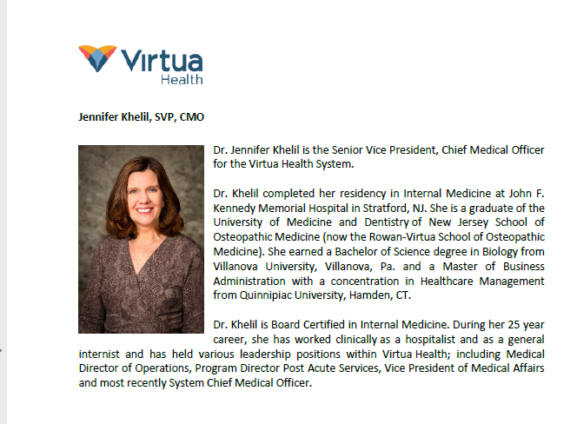

Slide 3
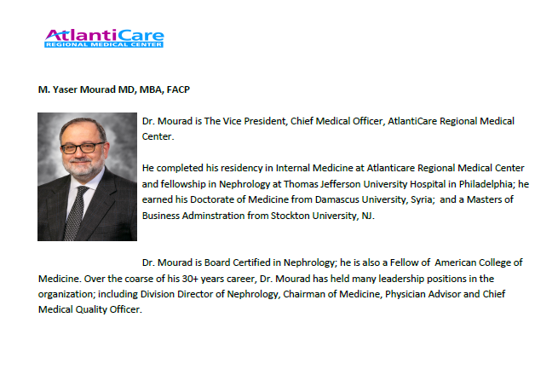

Slide 4
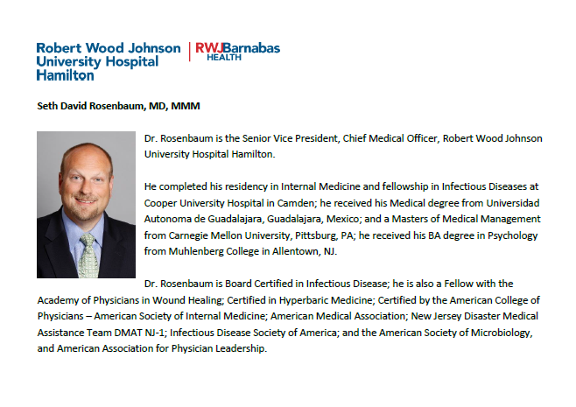

Slide 5

What is a CMO?
At the senior level, the Chief Medical Officer (CMO) is a licensed physician who has shifted practice to oversee clinical operations in the medical setting. Rather than directly care for patients at the bedside, CMOs act as liaisons between doctors and healthcare executives.
It is the Chief Medical Officer's duty to ensure patients receive the highest quality treatment possible by hiring, evaluating, and training new physicians. CMOs work to implement cost-effective, efficient medical interventions in nearly all healthcare facilities. CMOs create and enforce the clinical guidelines that make healthcare delivery run more smoothly.
https://www.bestcolleges.com/healthcare/chief-medical-officer-job/

Slide 6
Average Age/Tenure of CMO
CMO – Shortest-Tenured in C-Suite
The average CMO age is 54, which ties for youngest in the C-suite in this analysis and compares with an average age of 52 in the 2016 analysis. CMOs in the industrial sector are the oldest with an average age of 55. The youngest average age of CMOs is 52 in the consumer sector.
The average tenure of a CMO is the lowest of all C-suite titles, at an average of 3.5 years, down from the 2016 analysis, where the average tenure was 4.1 years. The longest average CMO tenure is in the industrial sector at 4.0 years, and technology industry CMOs have the shortest tenure at 3.0 years.
“Short CMO tenure is a reflection of a lack of understanding of how powerful this role can really be in terms of driving business outcomes,” said Caren Fleit, Korn Ferry leader, Global Marketing Officers Practice. “This often leads to lack of clarity around tangible deliverables and also to hiring a CMO whose skills and experiences may not be aligned with business needs.”
https://www.kornferry.com/about-us/press/age-and-tenure-in-the-c-suite

Slide 7

CMO Demographics
Research Summary. Using a database of 30 million profiles, Zippia estimates demographics and statistics for chief medical officers in the United States. Our estimates are verified against BLS, Census, and current job openings data for accuracy. After extensive research and analysis, Zippia's data science team found that:
There are over 12,519 chief medical officers currently employed in the United States.
35.5% of all chief medical officers are women, while 64.5% are men.
The average age of an employed chief medical officer is 46 years old.
The most common ethnicity of chief medical officers is White (60.9%), followed by Hispanic or Latino (14.7%), Black or African American (11.3%) and Asian (8.1%).
In 2021, women earned 91% of what men earned.
Chief medical officers are 74% more likely to work at private companies in comparison to public companies.
https://www.zippia.con/chief-medical-officer-jobs/demographics/

Slide 8
Questions for the Panel
Discuss your medical specialty and journey to become a CMO.
Do you still perform clinical services?
Does the Medical Staff Office report to you?

Slide 9
Intersecting roles of CMO and elected Medical Staff President
How do these roles differ?
Is there overlap between duties?
How important is the relationship between the CMO and the Medical Staff leadership?
Who is in charge?

Slide 10


Slide 11
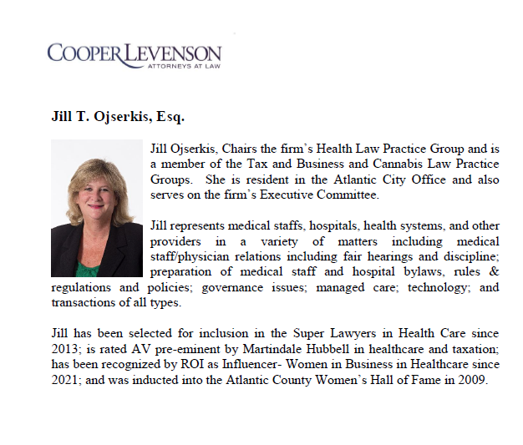

Slide 12
For further information please contact:
Jill Ojserkis (609) 572-7514 jojserkis@cooperlevenson.com
Brittany Bonetti (609) 572-7380 bbonetti@cooperlevenson.com
Cooper Levenson, PA
1125 Atlantic Avenue
Atlantic City, NJ 08401

