Slide 1
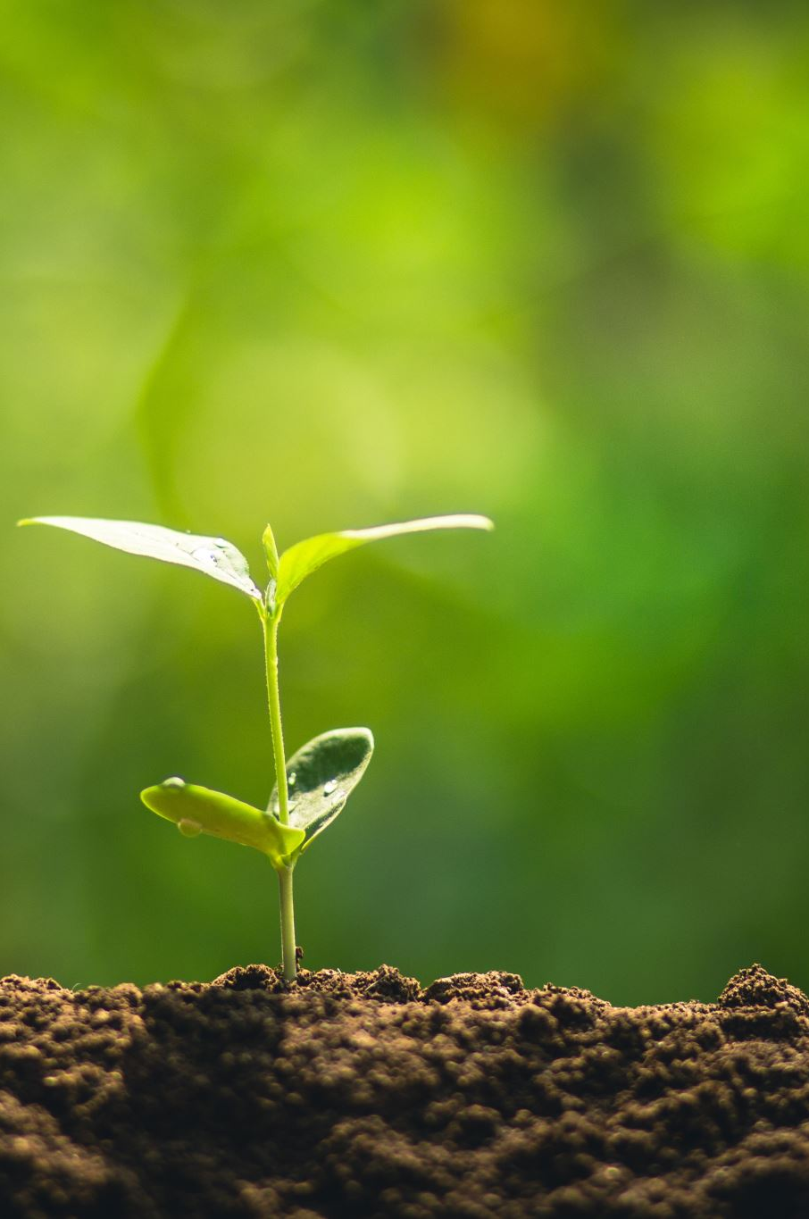
Making the Unconscious Conscious:
Learning to See One Another Beyond the Surface
Rosann Santos
April 27, 2023

Slide 2
Safe Space Agreements
Speak from your own experience
One person speaks at a time
Share the air (1-2 minutes please)
Be Respectful
Be Present and Curious

Slide 3

Preferences
Origin Story
Reflection and Mindfulness
What is it?
Why does it happen?
How do we address it?

Slide 4
Preferences
What is it?

Slide 5
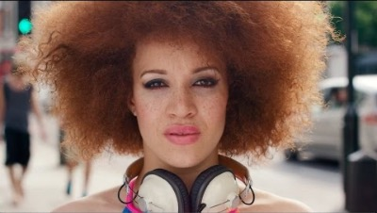
Unconscious Bias Explained

Slide 6

What’s your origin story?
Why does it happen?

Slide 7
Neuroplasticity
Why does it happen?

Slide 8

11,000,000
40
per second
10,999,960

Slide 9
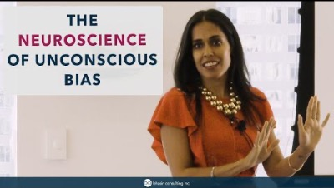

Slide 10




Shortcuts
Why does it happen?

Slide 11

Empathy
Broaden Your Horizons
Speak Up
Making Changes

Slide 12

Reflection & Mindset
How do I address it?

Slide 13



Q&A
Rosann Santos
RS@RosannSantos.com
@RSantosSpeaks

