Slide 1

Medical Staff
Meeting Management and Documentation
Bonnie Gutierrez, BHA, CPCS, CPMSM, FMSP
May 2, 2025

Slide 2
Today’s objectives
Develop a comprehensive understanding of the importance of Medical Staff meetings, from their essential role in improving patient care and safety, to their critical elements for ensuring regulatory compliance and mitigating risk of negligent credentialing.
Learn how to construct effective and efficient meeting agendas which align with best practices to elevate the functioning of governance committees.
Learn what key triggers exist for both regulatory non-compliance and negligent credentialing claims, and how to employ risk management tactics within meetings and documents in order to avoid these claims
Review best practices in recording decisions/actions items and assignments accurately., and how best to ensure confidentiality and data security of sensitive information.

Slide 3
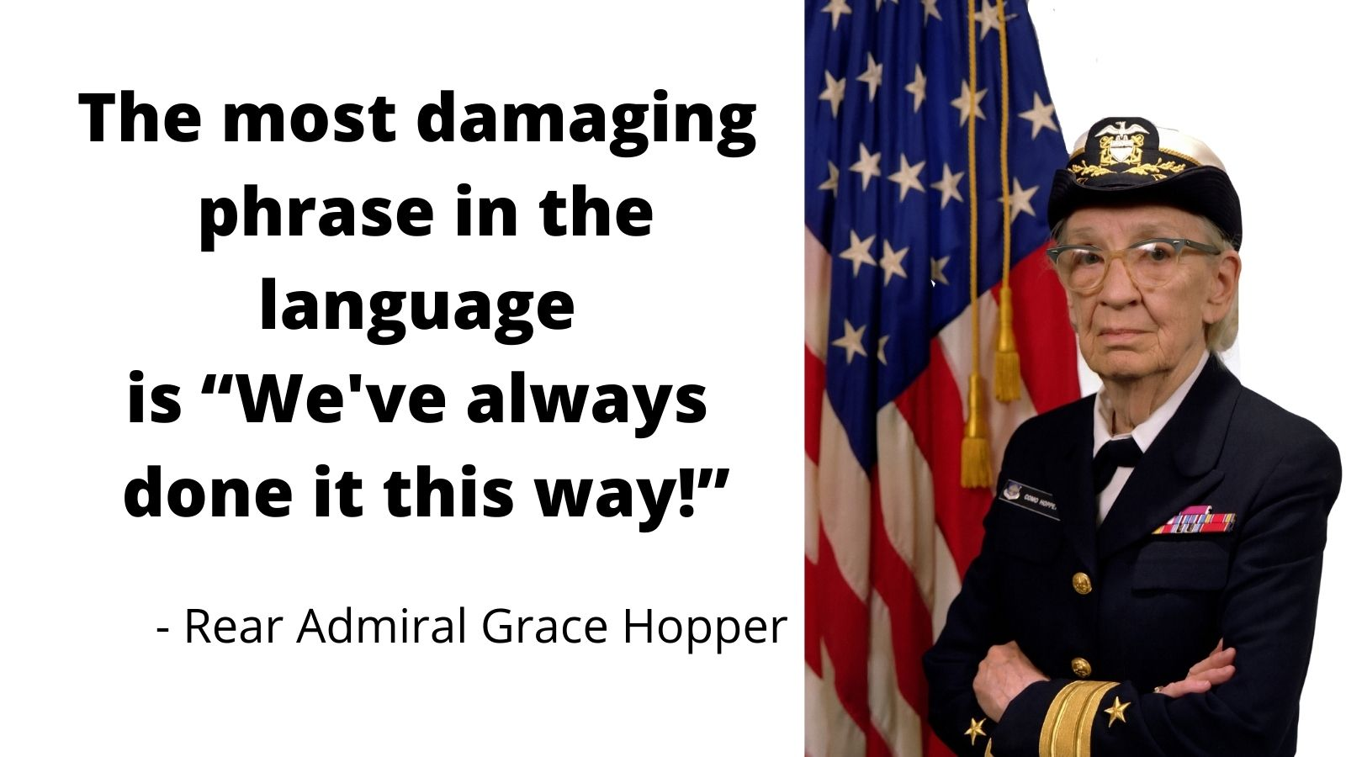

Slide 4
Why Meet?
Meetings are intended for the exchange/debate of ideas and Decision-making
Meetings are not for disseminating information…. Send a memo!
Information-flow is critical and regulatory-required.
Ensure reports are going both/all ways.
Department meeting agendas should always include a report from MEC, Quality, and relevant Clinical areas. Have CEO present last…physician will stick around!

Slide 5
Meeting preparation
Who’s job is it?
Chair of Committee
Administrators – Chief Medical Officer, Chief Executive Officer, Chair Nursing Officer
Meeting “Manager” – that would be you.
Who’s in the room?

Slide 6
Logistics and process
Review meetings rules/norms annually.
Maintain calendar of required reports
Set deadlines for materials to be presented
Establish expectations/rules for adding agenda items.
Address requests/expectations for guests/presenters
“Absent” vs. “Excused”
Deal with members who do not attend.

Slide 7
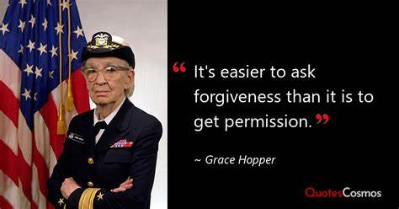

Slide 8
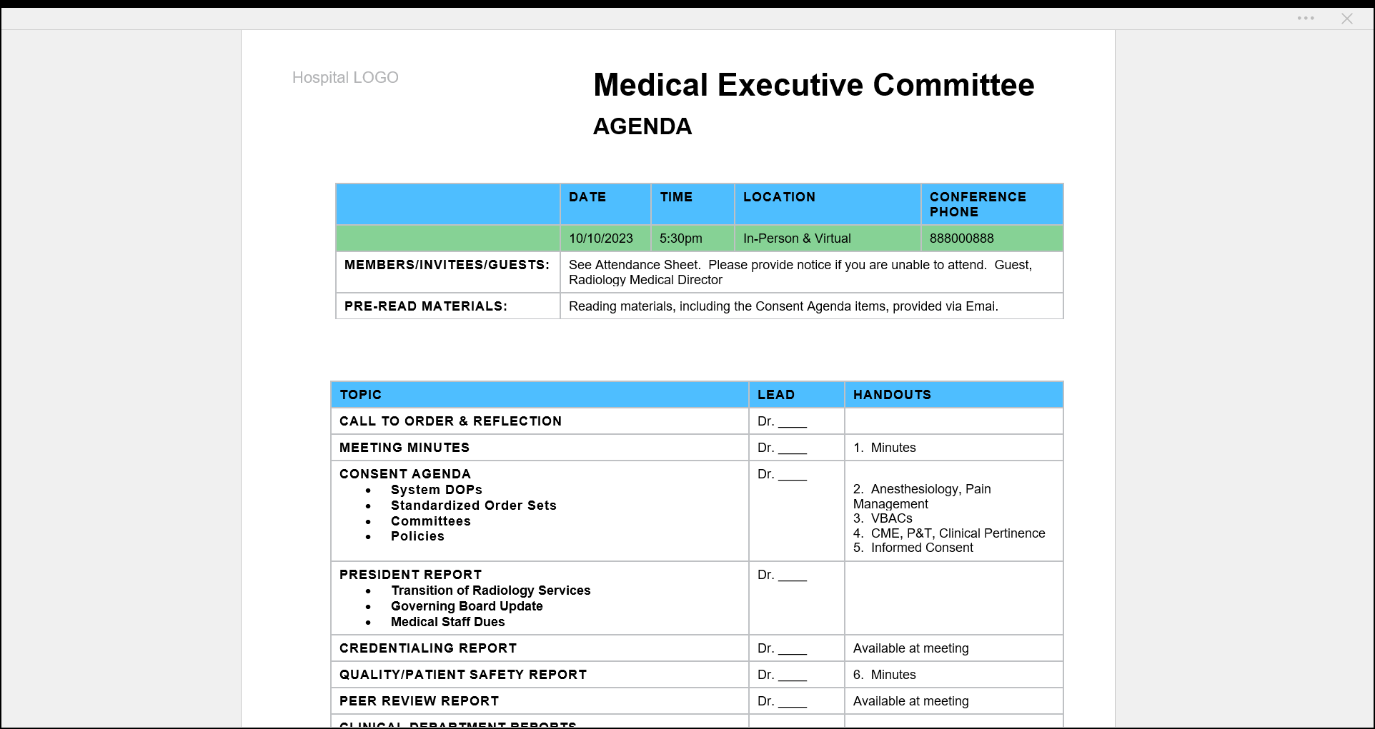

Slide 9
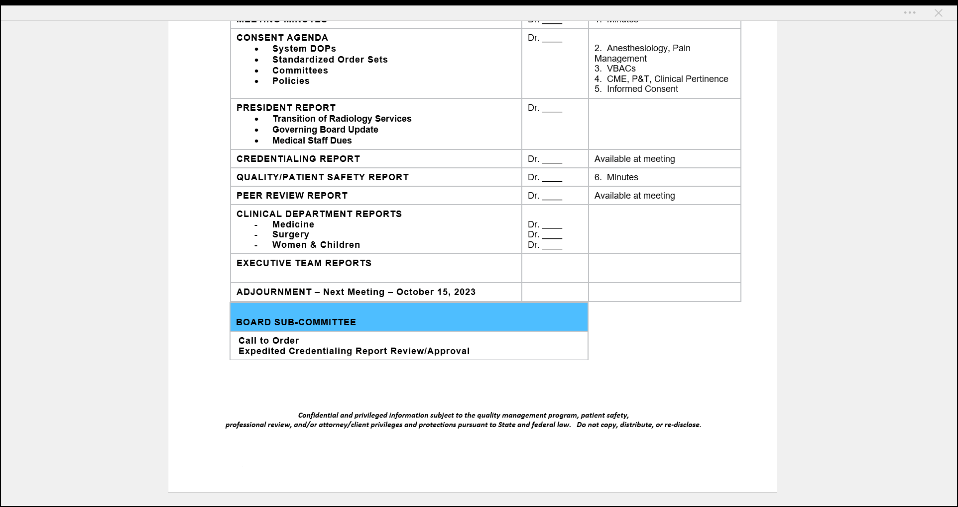

Slide 10
Consent Agendas
Check Bylaws, although most are silent on this topic.
Review purpose/process of Consent Agendas, including how to question or remove an item at orientation.
With agreement from Committee and guidance, Chair determines items for Consent Agenda.
Only effective if everyone thoroughly reviews the material to ensure nothing critical is included.
Don’t open the floor, invite comments or ask the representative if they have anything to add. “I will ask for a motion to accept all the items listed on the Consent Agenda.”
Never include actions specific to a provider, e.g. credentials issues, peer review reports.

Slide 11
Quorums and Voting
Meeting may still be “called to order”, but no actions may be taken.
Verify quorums before voting.
Committee members and leaders, ex-officio members, regularly-participating guests and you should all know who is allowed to vote.
Bylaws should delineate what percentages are required for motions to carry.

Slide 12
Executive Session
Verify and articulate purpose.
Separate the minutes and guard for access.
Know the quorum requirements and voting rights.
Executive Session Definition: A private portion of a meeting to handle sensitive and confidential business such as intra-committee disputes or CEO performance issues. Executive sessions are usually attended only by the committee members themselves. Shareholders, Executives, etc. are excluded unless they are specifically invited.

Slide 13

Minutes are minutes… not hours
Meeting Minutes should be succinct; summarize the important content of the discussions, outlining major points of the presentation and discussion; and correctly report all conclusions, recommendations or follow-up, as applicable.
Minutes should not be a verbatim account of discussions, only when they are required for hearings, appeals, etc. will a verbatim transcript may be required.
Document “reasonable effort” and followed agreed-upon processes.
Delineate the basis for actions.
Who’s reading them anyway?!?

Slide 14
Documentation of actions
Serves as an official record of business completed.
Reflects decision-making process and functionality of governance organization.
Demonstrates compliance with governance and regulatory requirements. (up/down communication)
Delineates conformance with notifications and fairness.
“If it’s not in the minutes, it didn’t happen.”

Slide 15
Key elements of minutes
Formats can change or be slightly modified.
Signatures vs. approval at next meeting.
Attendance
Pre-set paragraphs (credentials, peer review, quality wording) – Be Careful
“Minutes recorded by Bonnie Gutierrez, Director Medical Staff Services”
Confidentiality statement – every page
Title, page number and date on every page

Slide 16
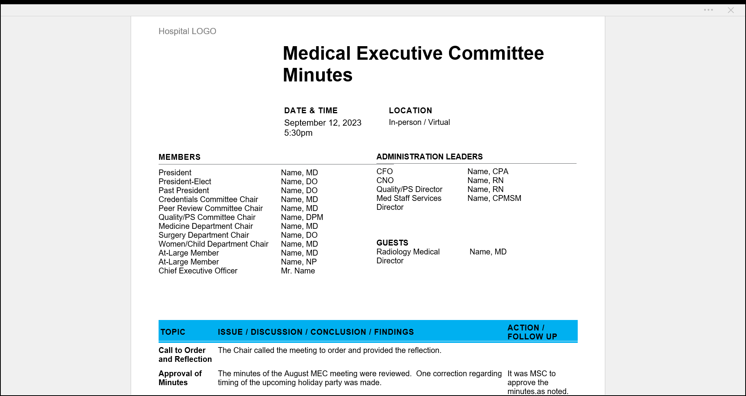

Slide 17
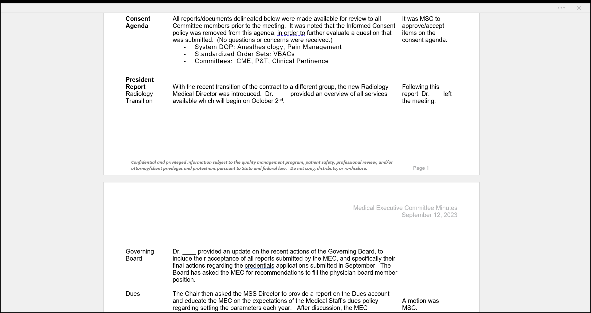

Slide 18
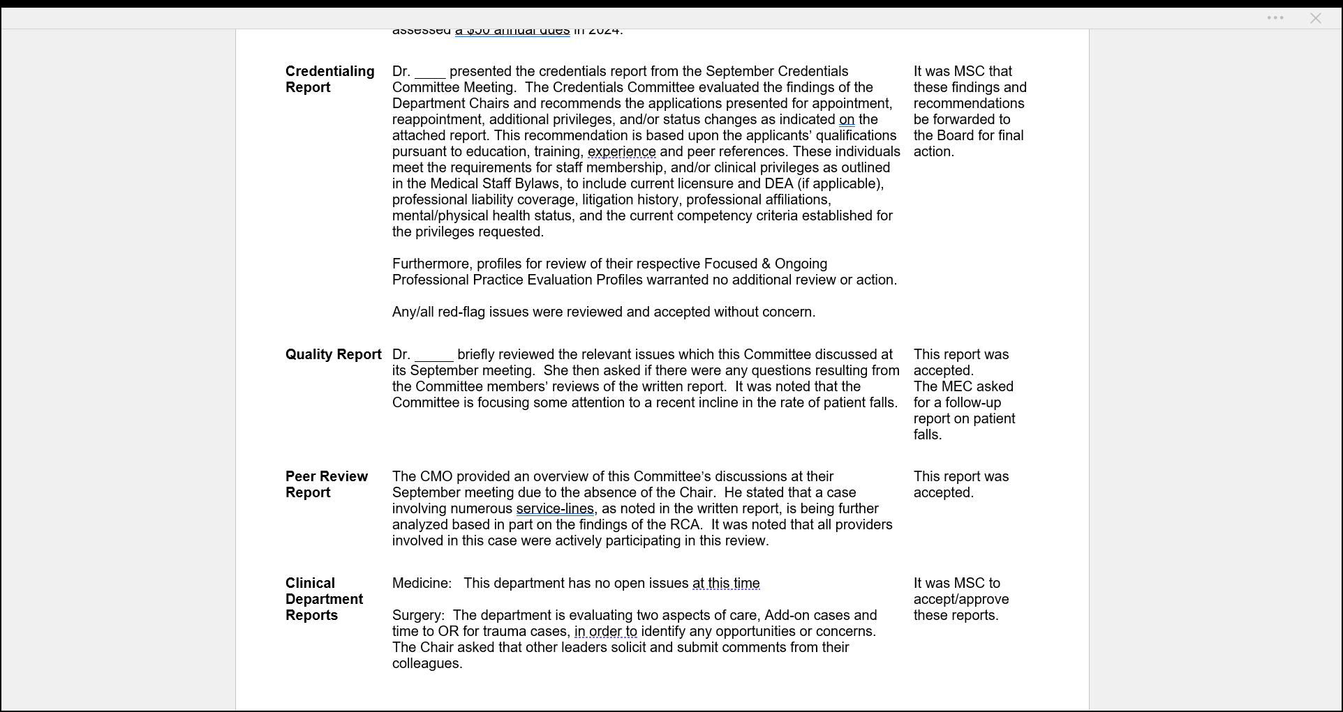

Slide 19
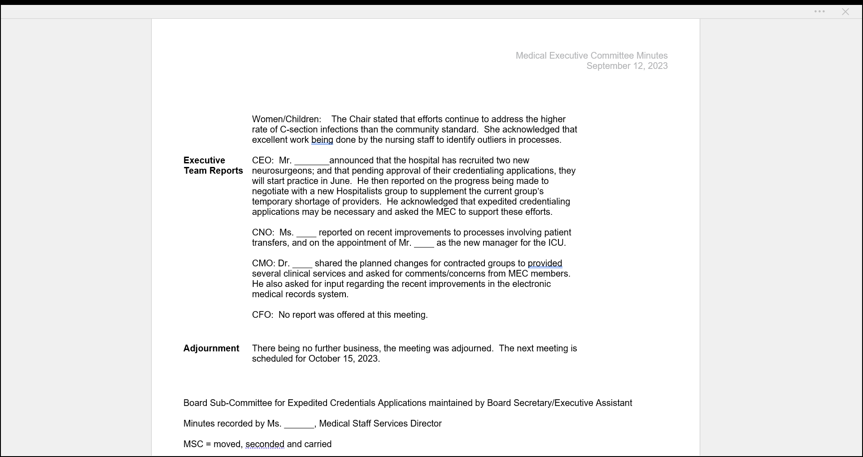
Notes:
Lastly, note the language under adjournment. Doesn’t that sound better than just…the meeting ended? This shows that the committee covered all the business at hand.
Note the comment about the Board Sub-Committee for expedited credentialing.
And finally, it denotes the use of the MSC acronym.

Slide 20
It was MSC that these findings and recommendations be forwarded to the Board for final action.
Dr. ____ , Credentials Chair, presented the credentials report from the September Credentials Committee Meeting. The Credentials Committee evaluated the findings of the Department Chairs and recommends the applications presented for appointment, reappointment, additional privileges, and/or status changes as indicated on the attached report. This recommendation is based upon the applicants’ qualifications pursuant to education, training, experience and peer references. With the exceptions noted below, these individuals meet the requirements for staff membership, and/or clinical privileges as outlined in the Medical Staff Bylaws, to include current licensure and DEA (if applicable), professional liability coverage, litigation history, professional affiliations, mental/physical health status, and the current competency criteria established for the privileges requested. All other red-flag issues were reviewed and accepted. Of note, Ms. _____, Physician Assistant, is lacking one of the ten procedures required in the DOP to be re-privileged in stress testing. The Credentials Committee is recommending that she be granted this privilege with the condition that her next stress test be performed in the presence of another provider holding this privilege (NP/PA/Cardiologist). Also of note, Dr. ______ application for initial appointment contains three peer references with high remarks; however, one reference is from an ICU Nurse Practitioner from his primary hospital, while the other two references are from Pulmonologists. It was verified that no additional Pulmonologists work in this more-rural hospital/area, where he has practiced for the past five years. Furthermore, profiles for review of their respective Focused & Ongoing Professional Practice Evaluation Profiles warranted no additional review or action.
The MEC determined the two exceptions to be acceptable. It was MSC that these findings and recommendations be forwarded to the Board for final action.

Slide 21
Use big words
Intent, clarity, style, image
The group talked about maybe sending him a letter or having him come in. They agreed to invite him to the next Medical Executive Committee meeting.
The Committee discussed the options of sending the physician an informative/instructional/ admonishment letter with a response being required, or whether an in-person meeting with the physician and the entire MEC would be more effective. It was decided that an in-person meet would be appropriately effective. The President will notify the physician of this requirement to attend the April MEC meeting in writing by March 10th, with an acknowledgement of his intent due by March 15th.

Slide 22
Professionalism
Sam presented the P&T report.
Ms. Samatha Jones, lead pharmacist, briefly reviewed the key points from the October P&T Committee meeting. A full report is attached.
Morre said that the hospital met budget this quarter.
CEO, Mr. Morre Dean, stated that the hospital met its operating budget for the third quarter.
Lucy talked about the upcoming community event.
Ms. Lucy Smith, a governing board member, was invited to share information on the upcoming community event, at which MEC participate is essential to create the intended goal.

Slide 23
Corrections
Changes/corrections to minutes may be made at the time when those minutes are submitted for approval, and should be made in the text of the minutes being approved. The minutes of the meeting at which the corrections are made should merely indicate that the minutes were approved "as corrected.“
Necessary corrections to previously approved minutes should be raised as a motion to amend something “Previously Adopted”.
Documentation might read as … “A Motion to Amend Something Previously Adopted has been made, seconded and passed. The following, corrected statement(s) has been added to the minutes of the November 11, 2023 MEC meeting minutes under the topic of Credentials Applications“. Be sure to make the change in the original minutes.
Typos are not corrections!

Slide 24
Access and maintenance
Educate all stakeholders on regulatory and risk-management issues…Get everyone on the same page and be prepared to rebuff requests!
Create excerpts of the minutes when appropriate.
Maintenance of minutes – forever!

Slide 25
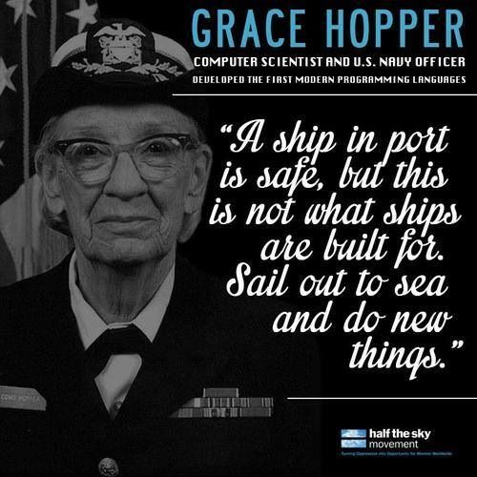
Questions???

Slide 26

Thank you and please feel free to reach out.
Bonnie Gutierrez, CPCS, CPMSM benloegutierrez@gmail.com
303-588-9160

