Slide 1
OPPE, FPPE, & PEER REVIEW
How, When, and Why
Part 1 – OPPE & FPPE Fundamentals

Slide 2

Sara Cameron, CPMSM, CPCS
Senior Director Professional Services & Senior Consultant
Sara Cameron serves as the Senior Director of Professional Services and a Senior Consultant at The Hardenbergh Group, bringing over 20 years of rich experience in healthcare administration, Medical Staff Services, and Graduate Medical Education. Throughout her career, she has partnered with large health systems to implement best practices in credentialing, privileging, peer review, professional development, and performance improvement.
Sara has made a significant impact by designing and implementing comprehensive professional practice evaluations and clinical peer review systems that enhance healthcare quality. Her efforts in establishing a central verification office enabled the standardization of credentialing practices across nine hospitals, leading to improved governance and efficiency. Through her innovative approach, she has fostered a culture focused on opportunities for improvement, effectively reducing complication rates, lengths of stay, and emergency department readmissions.
Additionally, Sara has been instrumental in transitioning organizations to electronic medical records and paperless credentialing processes. She has developed robust onboarding and orientation programs for physicians and medical staff leaders, ensuring they are well-equipped to tackle the challenges in healthcare.
A graduate of the NAMSS Leadership Certificate Program, Sara is an engaged leader within the National Association of Medical Staff Services (NAMSS), where she has held various volunteer and elected roles, including committee positions and board membership. Passionate about education, she has delivered extensive training sessions and authored several publications on medical staff leadership, making a lasting impact in the healthcare community.

Slide 3

DISCLOSURES
The information presented at this educational event and the supplementary materials provided to attendees are intended for educational and informational purposes only. Nothing contained therein is to be considered as the rendering of advice for specific cases or circumstances. No one should act or refrain from acting on the basis of any information presented at this event without seeking the appropriate legal or other professional advice on the particular facts and circumstances at issue.
In accordance with the Accreditation Council for Continuing Medical Education requirements on disclosure, Brock Bordelon, MD has no actual or potential conflict of interest, financial relationship/arrangement or affiliation with any entity producing, marketing, re-selling or distributing health care goods or services consumed by, or used on, patients.
In accordance with the Accreditation Council for Continuing Medical Education requirements on disclosure, Sharon Beckwith has no actual or potential conflict of interest, financial relationship/arrangement or affiliation with any entity producing, marketing, re-selling or distributing health care goods or services consumed by, or used on, patients.

Slide 4


Physician and APP Credentialing & Privileging

Slide 5
Why Do We Credential and Appropriately Privilege Physicians & APPs?
It’s all about competency
Responsibility of the medical staff to ensure that the physicians and APPs on staff are competent to perform the privileges they have been granted
This is your hospital caring for your community – the Medical Staff plays a crucial role in hospital governance
Included in this responsibility is helping to determine who is allowed to practice at your institution…and MSPs are crucial to this effort
Medical Staff Professionals
&
Hospital Administration

Slide 6

Who Owns It?
Repository of Institutional Memory/Knowledge
Governance
Quality
Peer Review
Credentialing
Bylaws
Medical Staff
Quality Team & Med Staff Professionals
…not the CEO

Slide 7
The Organized Medical Staff
Medical Staff Bylaws
GOVERNING BODY (BOARD)
MEDICAL STAFF
Trifurcated Hospital Governance
ADMINIS-TRATION
Trifurcated governance model:
  Governing body (Hospital Board)
  Administration
  Medical staff
Defined by Laws & Standards:
  Federal Law (Medicare Conditions of Participation)
  State Law
  Accreditation Standards (regulatory bodies – Joint Commission, DNV, etc.)
QUALITY
CMS Condition of Participation §482.22 - The hospital must have an organized medical staff … which is responsible for the quality of medical care provided to patients by the hospital.

Slide 8

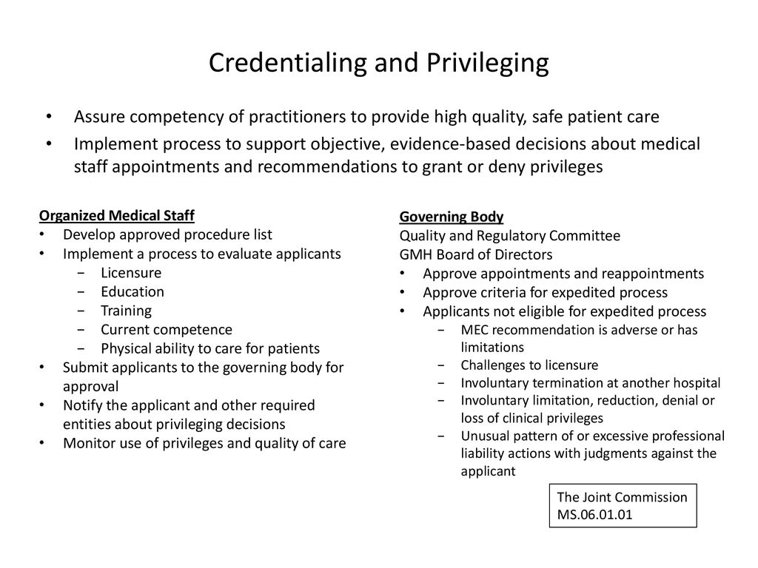
The Organized Medical Staff
Medical Staff
The medical staff is responsible for the quality of medical care provided to patients, and all of the component parts that go into that.
Subject to oversight by the governing body, but largely a self–governing entity.
Practitioners appointed to the medical staff must comply with the bylaws, rules and regulations, and policies that are adopted by the medical staff, as well as applicable hospital administrative policies.
Medical Staff Office Professionals are crucial to this effort
medical staff
CEO
CNO
“Admin”
Medical Staff Office Professionals

Slide 9

The Organized Medical Staff
Medical Staff Bylaws
Delineate patient care & behavior standards and protect medical staff members’ rights
Must be read and drafted carefully by the medical staff
Should be updated every 2-3 years (not just when something changes)
Must meet The Joint Commission / Hospital Accreditation standards
Should not conflict with corporate bylaws

Slide 10
Progressive Approach to Quality
“Life Cycle of Credentialing”
Credential Great Physicians & APPs
Re-Credential Great Physicians & APPs
Continuous/Ongoing Monitoring (OPPE)
Initial Monitoring Period (FPPE)
Set Expectations
Monitor Performance & Provide Feedback
Monitoring Finds a Potential Concern
Allow for Improvement
Persistent/Larger Concern?
Focused Monitoring (“Triggered FPPE”)
Manage Progressive Remediation

Slide 11
Progressive Approach to Quality
“Life Cycle of Credentialing”
Credential Great Physicians & APPs
Re-Credential Great Physicians & APPs
Set Expectations
Data Input
PRC Decision
Monitor Performance & Provide Feedback
OPPE/Ongoing Monitoring
Care Acceptable
Peer Review
Minor Opportunity for Improvement
Case Review(s)
Allow for Improvement
FPPE/Focused Monitoring
Manage Progressive Remediation
Major Opportunity for Improvement

Slide 12
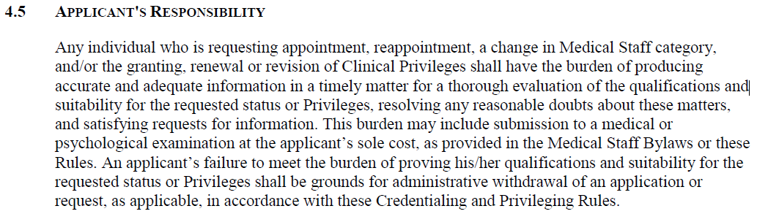
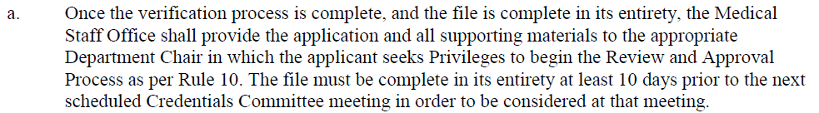
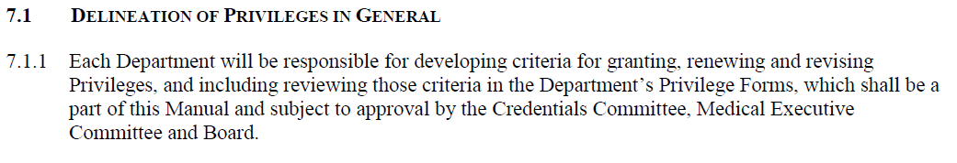
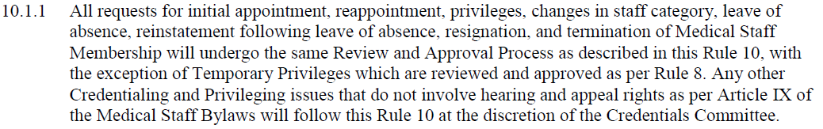
Credentialing & Privileging
Practitioner
Maintain and document competency
MSP
Assure documentation is evident to verify that
the defined criteria are met
Medical Staff
Define the criteria used to determine competency
MEC
Review information, make informed decision regarding the
privileges requested, & make recommendations to the Board
(+Credentials)
Governing Body
Review Medical Staff recommendations & render final decision

Slide 13






Credentialing & Privileging
Credentialing – Uniform Process
*
Privileges – What the applicant is allowed to do
Application
*
Department Chair +/- CMO
Credentials Committee
Medical Executive Committee
Board / Governing Body

Slide 14


Credentials Committee Chair
Experience counts – frequently filled by the immediate past President of the Medical Staff/Chief of Staff
This position is critical to ensuring competent patient care
Requires much more than reviewing applications – processes and policies are just as (or more) important
  An ad hoc approach to policies is unwise
  If you don’t have a policy in place to follow….develop one first before granting privileges (e.g., new procedure, credentialing disputes)
  A close working relationship with the Medical Staff Office Professionals is essential
The Credentials Chair should be very comfortable saying “NO” when necessary

Slide 15
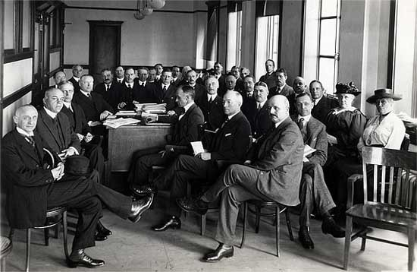
Credentials Committee Member Responsibilities
Understand relevant requested privilege requirements
Be familiar with Peer Review, OPPE and FPPE data
Process & Policies matter
  Delineation of privilege forms
  Requests for new privileges
Unanticipated / new information with re-application needs complete committee evaluation
The applicant bears the burden of providing a complete application
Not a “Rubber Stamp” process
Understand confidentiality of the process
Credentials Committee

Slide 16

F/OPPE Fundamentals
Practicalities

Slide 17

Meet Dr. Neo
Dr. Neo is a recent residency and fellowship trained surgical specialist and has applied for privileges at your hospital.
Dr. Neo’s application was submitted, the medical staff services team has performed primary source verification and completed all necessary steps to present this applicant to the credentials committee.
Now what?

Slide 18

Granting Privileges Should Be
A documented, objective, and evidence-based process.
Based on defined criteria including training, experience and demonstrated current competence.
Based on services provided at the facility or location.
Consistently and uniformly applied for all applicants.
Reviewed Regularly – a periodic review of each specialty’s Delineation of Privileges (DOP), with input from medical staff members (focus for Department Chair)
Credentialing
&
Privileging
* FPPE
When there are questions or concerns raised about an applicant, the application should be considered incomplete and not processed until those concerns are resolved.

Slide 19
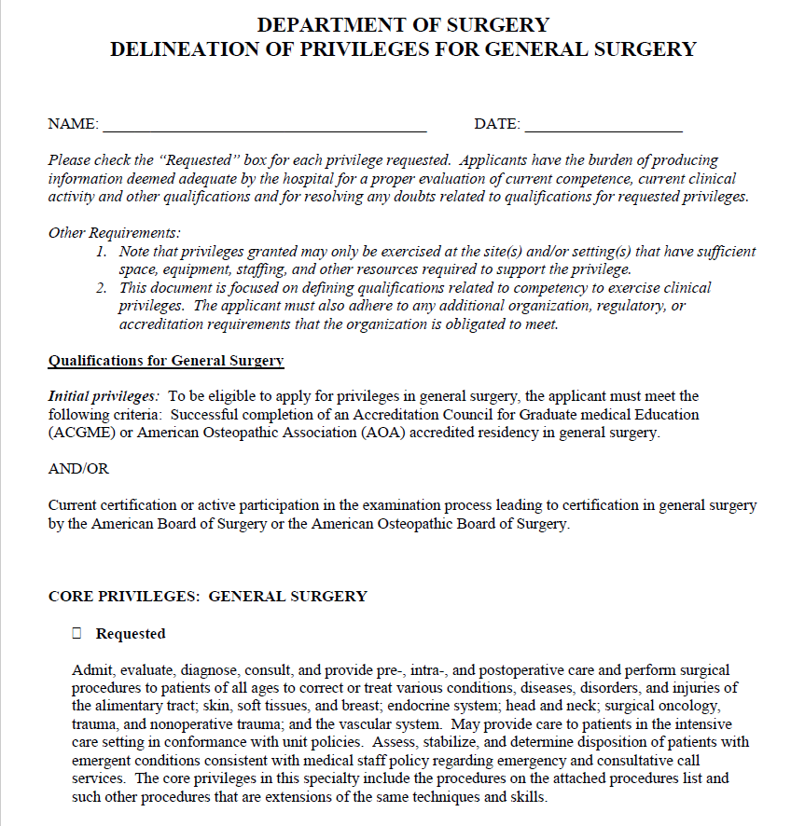
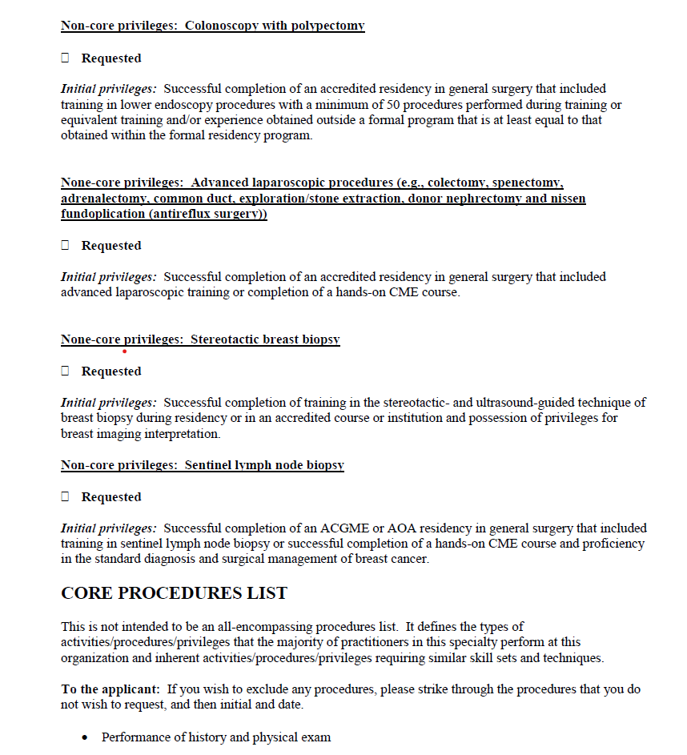
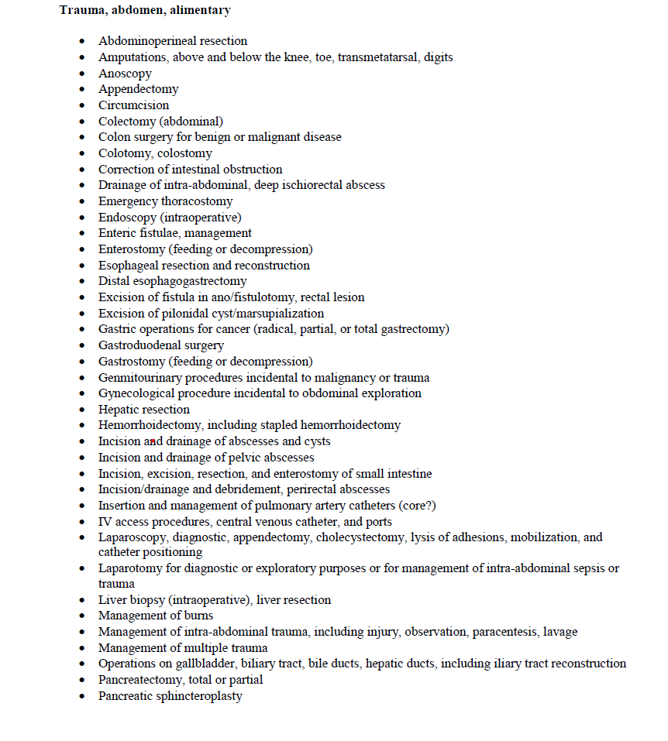
Privileging Process Considerations:
“Laundry List” vs. Core vs. Category
Developing minimum threshold criteria
Special procedures & training criteria
Consideration of Proctoring
Approval of forms
Privilege form maintenance
Clear, written, & periodically reviewed clinical privilege delineations…regardless of setting
Credentialing
&
Privileging

Slide 20


Dr. Neo was granted clinical privileges.
All providers with newly granted privileges should (must) be reviewed for a volume or time limited period.
This is done via a focused period of practice quality evaluation (FPPE or equivalent)
MS.08.01.01 Focused Professional Practice Evaluation
The Organized Medical Staff defines
the circumstances requiring focused
monitoring and evaluation of a
practitioner’s professional
performance.

Slide 21

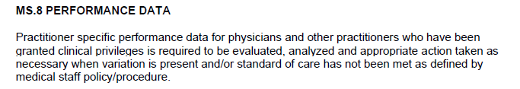
Dr. Neo was granted clinical privileges.
All providers with newly granted privileges should (must) be reviewed for a volume or time limited period.
This is done via a focused period of practice quality evaluation (FPPE or equivalent)
DNV does not require an FPPE process for newly granted privileges, but does require collection and evaluation of practitioner-specific performance data.

Slide 22
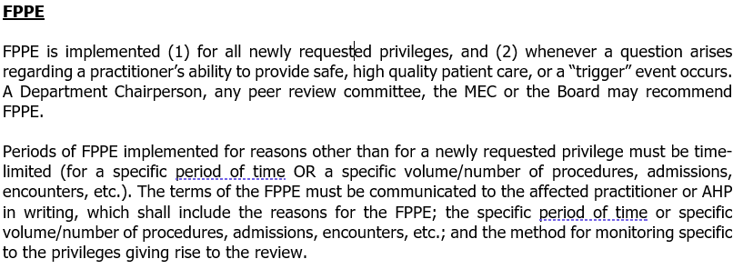
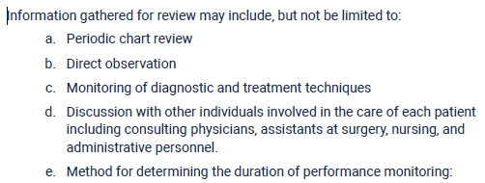
Focused Professional Practice Evaluation
FPPE or Equivalent - Initial Granting of Privileges
FPPE allows evaluation of the privilege-specific competence of a practitioner who does not have documented evidence of clinical activity at your organization, including:
Newly appointed practitioners
When new privilege(s) are granted
For established medical staff members, a focused review can be undertaken when questions concerning competence are raised (“Triggered FPPE”)
Data may be collected through any of the following methods: concurrent or retrospective chart reviews, monitoring clinical practice patterns, simulation, proctoring, external peer review, or discussions with peers
FPPE is time-limited

Slide 23

Focused Professional Practice Evaluation
Time frame is defined by your polices
Use timelines to keep everyone informed of time frame and progress
What if not enough of the clinical activity has taken place during the allotted time?
  Can be extended, as long as the rationale is documented
  But……this can’t be an unlimited time frame
FPPE is time-limited

Slide 24
Focused Professional Practice Evaluation
Initial Granting of Privileges
Dept Chair reviews data and makes an informed decision re: continuing or concluding FPPE
Credentials Committee in collaboration with the department chair develops criteria for evaluation
Department Chair
DOP Forms
Initial FPPE Criteria – based upon clinical privileges
Outcome Data is gathered
Analyze Data

Slide 25


Dr. Neo passes through his 6 month initial FPPE / focused evaluation period with no concerns being raised
“But wait, there’s more!”
“I’m good, right?”

Slide 26

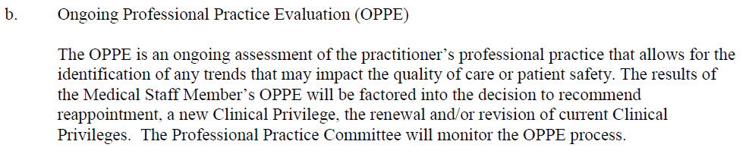
Every member of the medical staff who is granted clinical privileges should (must) participate in continuous / ongoing quality of care monitoring (OPPE or equivalent)
Dr. Neo is no different…
MS.08.01.03
OPPE allows the organization to identify practice trends that impact quality of care

Slide 27
Every member of the medical staff who is granted clinical privileges should (must) participate in continuous / ongoing quality of care monitoring (OPPE or equivalent)
Dr. Neo is no different…
DNV does not require an OPPE process for newly granted privileges, but does require collection and evaluation of practitioner-specific performance data.

Slide 28
Ongoing Professional Practice Evaluation
Competency is a Combination of Two Principles
Ongoing Professional Practice Evaluation / Monitoring
(OPPE)
--------
The process by which the Organized Medical Staff evaluates the current clinical competency of every licensed individual practitioner exercising privileges using appropriate quantitative and qualitative data.
[1] Have you done it recently?
Numbers – How Many, How Often?
[2] When you did it, did you do it well?
Quality Metrics

Slide 29
Ongoing Professional Practice Evaluation
Outcome Data is gathered
Dept Chair reviews data for outliers and opportunities for improvement
Departments define data for areas of competency
Medical Knowledge
Practice-Based Learning
Patient
Care
Analyze Data
Core Competencies
Systems-Based Practice
Interpersonal & Communication Skills
Professionalism

Slide 30
OPPE Requirements
Quality Indicators
  Measures should be clearly defined
    Different service lines require different indicators
  Who reviews the data should be clearly defined
  The process must be clearly defined
  Results should be (must be) used in credentialing and peer review
  Focused & Continuous / Ongoing practice quality monitoring should be (must be) applied to all privileged practitioners
General “Core” Competencies Assessment ~ Everyone ~
Medical Knowledge
Practice-Based Learning
Patient
Care
Core Competencies
Systems-Based Practice
Interpersonal & Communication Skills
Indicators are defined by the Medical Staff Departments
Correlating with core competencies and clinical privileges
Professionalism

Slide 31
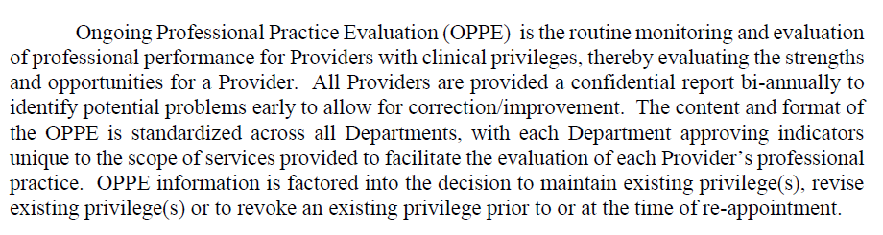
OPPE Requirements
General “Core” Competencies Assessment ~ Everyone ~
Indicators by Service Line
“Triggers” are unacceptable levels of performance within established defined criteria
  Prolonged Length of Stay compared to peers
  Defined # of individual peer reviews w/ adverse determinations
  Elevated infection rates
  Blood loss greater than specified amount in the OR
  Unscheduled return the ED within 24 hours of discharge
  Unexpected returns to OR
  Failure to meet core measure guidelines – stroke, sepsis and cardiac alerts
  Outliers in patient satisfaction data/high level of complaints
  Utilization of tests, procedures, and consultants
  Blood and pharmaceutical usage
Medical Knowledge
Practice-Based Learning
Patient
Care
Core Competencies
Systems-Based Practice
Interpersonal & Communication Skills
Professionalism

Slide 32
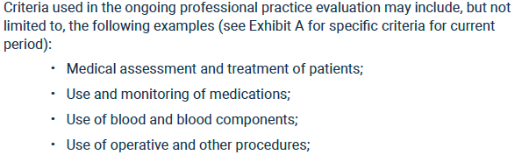
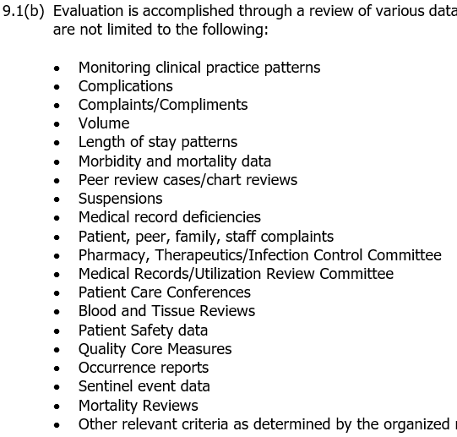
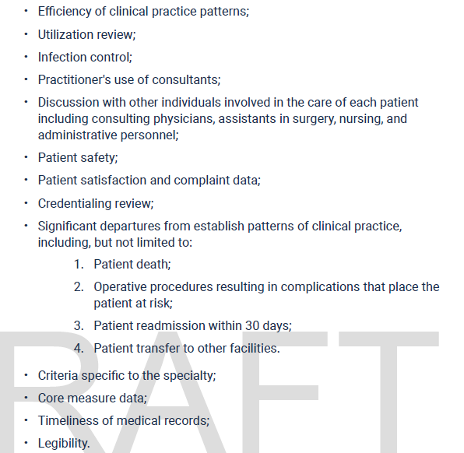
OPPE Requirements
General “Core” Competencies Assessment ~ Everyone ~
Medical Knowledge
Practice-Based Learning
Patient
Care
Core Competencies
Systems-Based Practice
Interpersonal & Communication Skills
Professionalism

Slide 33
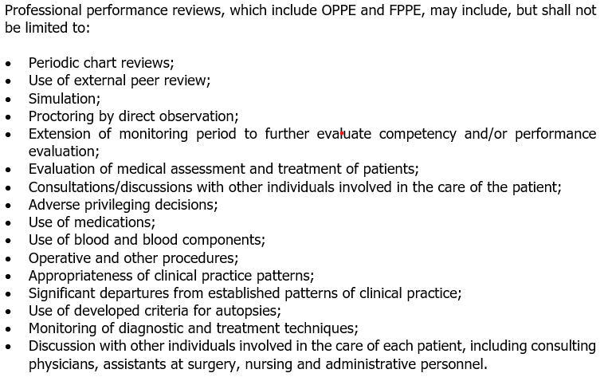
OPPE Data
“Ongoing” = At Least Annually
      OPPE – refer to data that exists, monitoring common practice areas
        Compare to department norms
        Compare to national norms
    Specific Practitioner Feedback
    Provide performance data on a routine basis to each physician & APP

Slide 34
OPPE Data
“Ongoing” = At Least Annually
Data Benchmarks & Thresholds
Benchmarks - Based on recognized standards when available, the expected results of a Provider practicing at the Hospital.
Thresholds - The minimum results of a Provider practicing at the Hospital recognizing that low volumes can result in a short term sub-threshold result in a given indicator. When sub-threshold results persist, consideration must be given to identify opportunities for improvement.
Comparative Data - De-identified comparative Department data may be presented in aggregate to influence performance.
      OPPE – refer to data that exists, monitoring common practice areas
        Compare to department norms
        Compare to national norms
    Specific Practitioner Feedback
    Provide performance data on a routine basis to each physician & APP

Slide 35
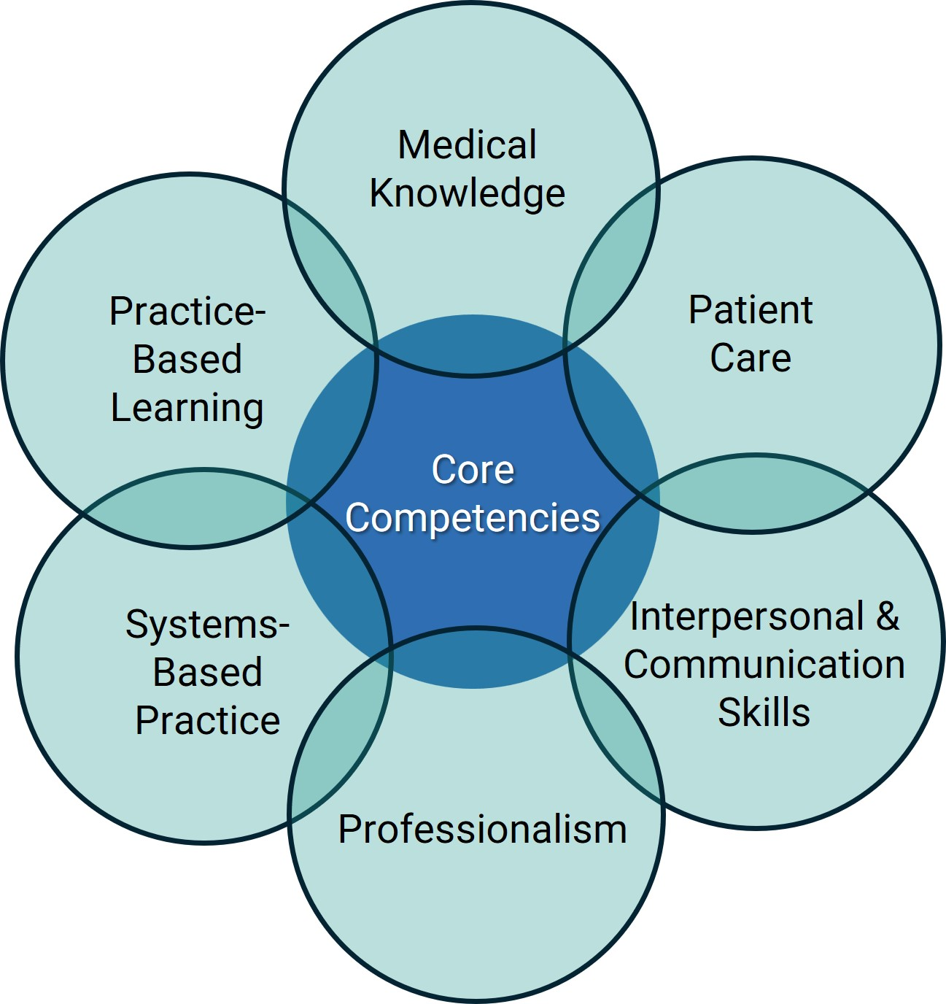
OPPE Use in Assessing Competency
Patient Care provides appropriate and effective patient care for the treatment of health problems. | Peer review findings – case reviews FPPE reports/findings Clinical complaints/compliments Crimson data Level of clinical activity Mortality Complications of condition or care 30-day readmissions for same MS-DRG Medical Record Delinquency H&P Audits Current board certification CME attestation Most current peer references
MEDICAL KNOWLEDGE Demonstrates knowledge about established and evolving biomedical, clinical, epidemiological and social behavioral sciences as well as the application to patient care.
PRACTICE-BASED LEARNING AND IMPROVEMENT Demonstrates the ability to investigate and evaluate patient care practices, appraises and assimilates scientific evidence to continuously improve patient care based on constant self- evaluation and life-long learning.
INTERPERSONAL AND COMMUNICATION SKILLS Demonstrates interpersonal and communication skills that result in effective information exchange and collaboration with patients, their families, and the healthcare team. | Professionalism complaints/compliments Compliance with applicable Medical Staff and organization policies and procedures Timely and adequate completion of patient records
PROFESSIONALISM Demonstrates a commitment to carrying out professional responsibilities, and adherence to ethical principles.
SYSTEMS-BASED PRACTICE Demonstrates awareness of and responsiveness to the larger context and system of health care and the ability to effectively call on other resources in the system to provide optimal health care. | Length of Stay Committee involvement
?
Fine Tune OPPE Indicators Over Time

Slide 36



OPPE Use in Assessing Competency
  Fundamentally, organizations must collect all performance data covering all elements of performance
    Each practitioner’s OPPE should (must) be evaluated by a Medical Leader for current competency (Chief of Department)
    Comparative Reports
      Physician profiles should (must) be compared to external benchmark data & compared to others in the same department
    OPPE must be done more often than annually – practically, every 6 or 8 months
    Specific Practitioner Feedback
      Provide performance data on a routine basis to each physician
    Low volume providers can be challenging to assess
    Time intensive – automate data collection & report generation as much as is feasible to ease the burden on the Quality Team and Medical Staff leaders

Slide 37









OPPE Use in Assessing Competency
    Comparative Reports
      Physician profiles must be compared to external benchmark data and compared to others in the same department

Slide 38





OPPE Use in Assessing Competency
Stretch your dollars…

Slide 39
OPPE Data
      Data Evaluation
      Who?
      When?
      Then What?
Data Review & Evaluation
Data review and evaluation is performed by the Department Chair prior to distribution to the Provider. The data is confidential and used by the Department Chair during the Reappointment process.
Exemplary Care – no changes in monitoring
High-Level Quality Care - no changes in monitoring
Potential Opportunity for Improvement – continued monitoring, with education provided as needed
Opportunity for Improvement –
  If indicator is met with next OPPE period, continue monitoring
  If not ➡️ a Focused PPE plan may be implemented with more frequent monitoring

Slide 40
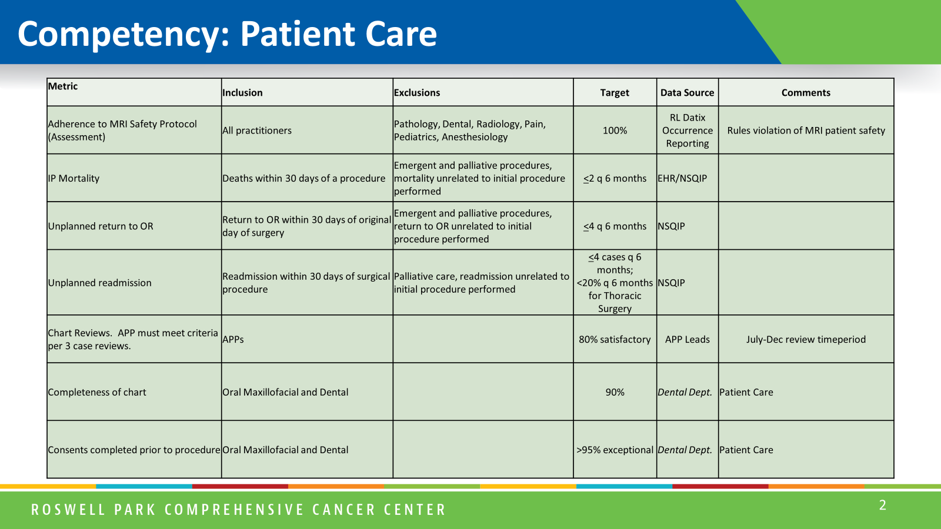
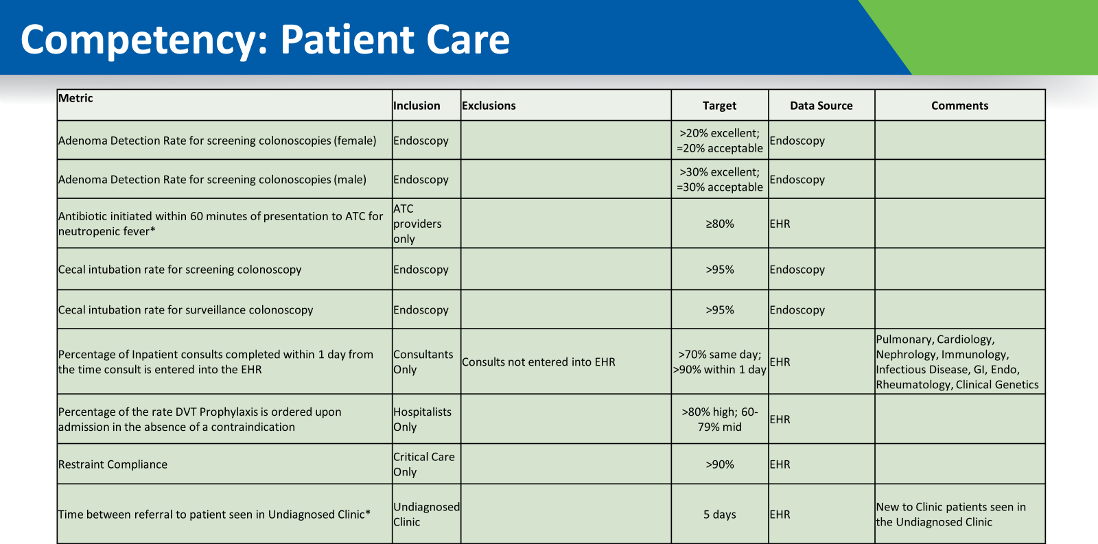
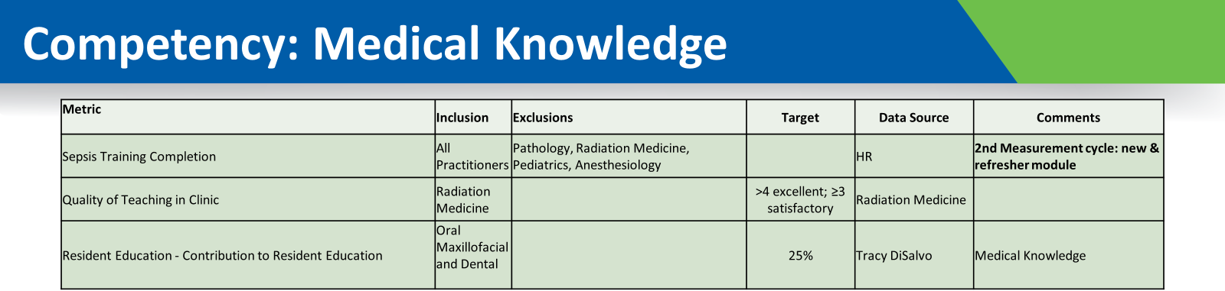
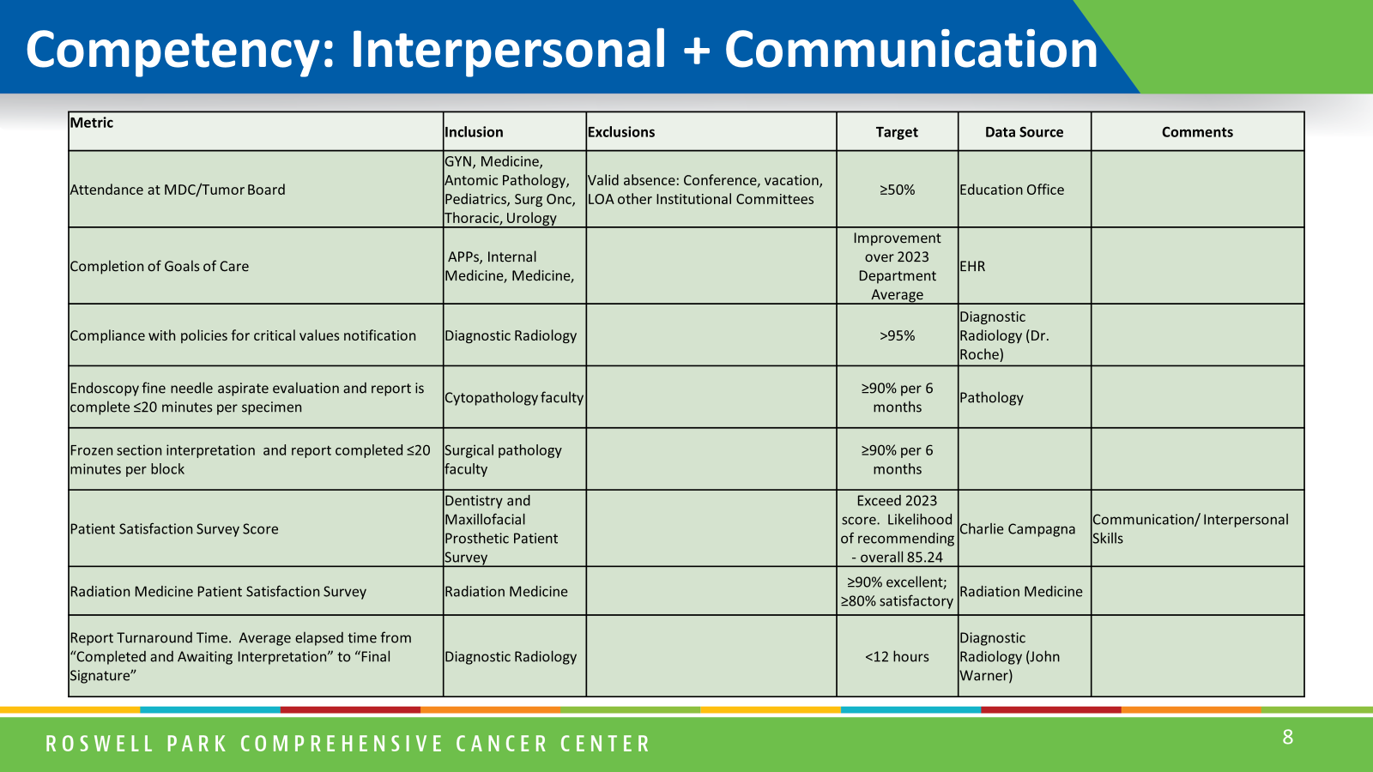
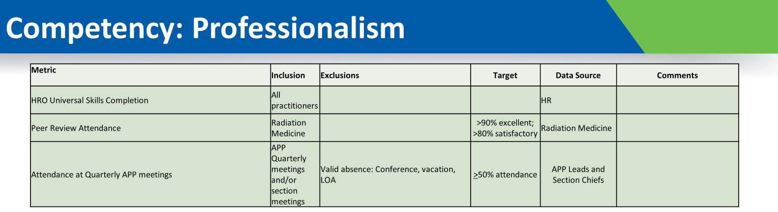
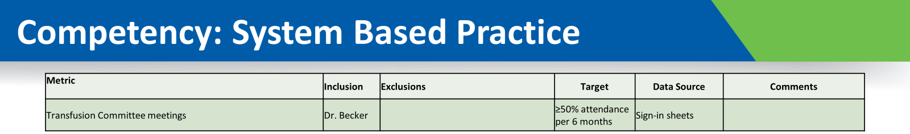
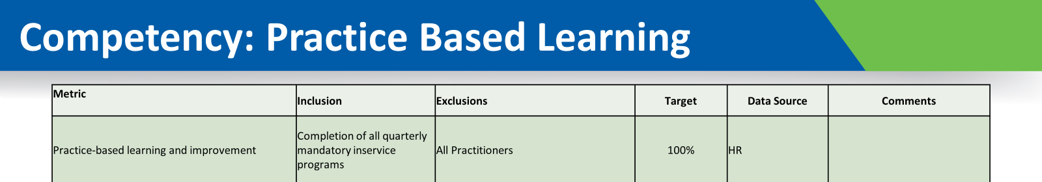
OPPE Use in Assessing Competency

Slide 41
Medical Staff Professional’s Role
Supporting Medical Staff Leaders
Provide dedicated time for Medical Staff Leaders
Complete documentation
    “The whole (hi)story”
    Demonstrate timeline & interventions as outlined by bylaws
Arrange availability of HR and Legal teams as required
Ensure accountability
Initial FPPE
Triggered FPPE
Behavior Concern
OPPE
Completed FPPE

Slide 42
Determination of Competency
TJC and DNV surveyors will be looking for documentation of the hospital’s FPPE/OPPE processes and how they are applied to the credentialing and privileging process for its practitioners.
      Facilities can be cited for lack of robust OPPE/FPPE processes
      Initial FPPE can be cited for lack of timeliness and lack of documentation
      “For cause/Triggered” FPPE frequently gets cited for lack of action and on-going measurement
      Does OPPE and FPPE data feed back to the credentialing body?
      Bottom Line : OPPE/FPPE must be more than just a paper process
F / OPPE

Slide 43
Determination of Competency
FPPE
…etc
OPPE
Peer
OPPE
Re-Credentialing
OPPE
OPPE
Peer
Re-Credentialing
OPPE
OPPE
FPPE
Peer

Slide 44

Reporting Requirements
OPPE and FPPE information is reported to the MEC and the Board
OPPE and FPPE are parts of the peer review process – protected
  They are not adverse actions
  They are not “investigations”
  They are not reportable to the National Practitioner Data Bank or State Medical Board
  They are part of feedback and, if needed, managing poor performance
F / OPPE

Slide 45
F/OPPE Information Flow
Medical Executive Committee
The MEC reviews recommendations of the Credentials Committee and takes action which
may include endorsement, modification or return to Credentials Committee for further review.
This recommendation is then forwarded to the Board of Directors.
Department Chair
Prior to distribution, the respective Department Chair reviews the OPPEs for the Department to identify any unexpected data trends.
After validating data, a letter of explanation
is prepared personally for each medical staff member
Credentials Committee
The Credentials Committee reviews the OPPE with each re-appointment to assess if privilege(s) can be recommended as requested, denied, or require modification.
Recommendations of the Credentials Committee are discussed at the Medical Executive Committee.
Peer Review / Professional Practice Committee
FPPE plans are reviewed on a monthly basis to review progress toward achieving the goal.
Medical Staff Indicators are reviewed biennially or more frequently as needed, with the Department to ensure the data being collected is supporting process improvement efforts.
Provider
The respective Department specific report is provided to the Provider. Details about data
may be clarified by contacting the Medical Staff Office for identification of specific cases which
are attributed to the performance indicators. After review, any concerns should be directed to the
Department Chair or the Chair of PPC.
Peer Review / Professional Practice Committee
Department Chair
Provider
Credentials Committee
Medical Executive Committee

Slide 46
Why Do We Credential and Appropriately Privilege Physicians & APPs?
It’s all about competency

Slide 47




Slide 48


Let’s Chat!
SCameron@HardenberghGroup.com

