Slide 1

OPPE, FPPE, & PEER REVIEW
How, When, and Why
Part 2 – F/OPPE, Credentialing, and Peer Review: Getting in Sync
New Jersey State Association Medical Staff Services
May 1 -2, 2025

Slide 2

Sara Cameron, CPMSM, CPCS
Senior Director Professional Services & Senior Consultant
Sara Cameron serves as the Senior Director of Professional Services and a Senior Consultant at The Hardenbergh Group, bringing over 20 years of rich experience in healthcare administration, Medical Staff Services, and Graduate Medical Education. Throughout her career, she has partnered with large health systems to implement best practices in credentialing, privileging, peer review, professional development, and performance improvement.
Sara has made a significant impact by designing and implementing comprehensive professional practice evaluations and clinical peer review systems that enhance healthcare quality. Her efforts in establishing a central verification office enabled the standardization of credentialing practices across nine hospitals, leading to improved governance and efficiency. Through her innovative approach, she has fostered a culture focused on opportunities for improvement, effectively reducing complication rates, lengths of stay, and emergency department readmissions.
Additionally, Sara has been instrumental in transitioning organizations to electronic medical records and paperless credentialing processes. She has developed robust onboarding and orientation programs for physicians and medical staff leaders, ensuring they are well-equipped to tackle the challenges in healthcare.
A graduate of the NAMSS Leadership Certificate Program, Sara is an engaged leader within the National Association of Medical Staff Services (NAMSS), where she has held various volunteer and elected roles, including committee positions and board membership. Passionate about education, she has delivered extensive training sessions and authored several publications on medical staff leadership, making a lasting impact in the healthcare community.

Slide 3

DISCLOSURES
The information presented at this educational event and the supplementary materials provided to attendees are intended for educational and informational purposes only. Nothing contained therein is to be considered as the rendering of advice for specific cases or circumstances. No one should act or refrain from acting on the basis of any information presented at this event without seeking the appropriate legal or other professional advice on the particular facts and circumstances at issue.
In accordance with the Accreditation Council for Continuing Medical Education requirements on disclosure, Brock Bordelon, MD has no actual or potential conflict of interest, financial relationship/arrangement or affiliation with any entity producing, marketing, re-selling or distributing health care goods or services consumed by, or used on, patients.
In accordance with the Accreditation Council for Continuing Medical Education requirements on disclosure, Sharon Beckwith has no actual or potential conflict of interest, financial relationship/arrangement or affiliation with any entity producing, marketing, re-selling or distributing health care goods or services consumed by, or used on, patients.

Slide 4

Dr. Neo has been on staff for two years and is now due for reappointment
“Current competence” for privileges requested
Provider profile – OPPE/FPPE*
Peer Reviews
License & DEA Certificates
CME
Liability Insurance
NPDB “sweep” & Criminal Background Check

Slide 5





F/OPPE Information Flow
Medical Executive Committee
The MEC reviews recommendations of the Credentials Committee and takes action which
may include endorsement, modification or return to Credentials Committee for further review.
This recommendation is then forwarded to the Board of Directors.
Department Chair
Prior to distribution, the respective Department Chair reviews the OPPEs for the Department to identify any unexpected data trends.
After validating data, a letter of explanation
is prepared personally for each medical staff member
Credentials Committee
The Credentials Committee reviews the OPPE with each re-appointment to assess if privilege(s) can be recommended as requested, denied, or require modification.
Recommendations of the Credentials Committee are discussed at the Medical Executive Committee.
Peer Review / Professional Practice Committee
FPPE plans are reviewed on a monthly basis to review progress toward achieving the goal.
Medical Staff Indicators are reviewed biennially or more frequently as needed, with the Department to ensure the data being collected is supporting process improvement efforts.
Provider
The respective Department specific report is provided to the Provider. Details about data
may be clarified by contacting the Medical Staff Office for identification of specific cases which
are attributed to the performance indicators. After review, any concerns should be directed to the
Department Chair or the Chair of Peer Review.
Peer Review / Professional Practice Committee
Department Chair
Provider
Credentials Committee
Medical Executive Committee

Slide 6
Medical Staff Reappointments
The Credentials Committee is responsible for reviewing and verifying the credentials of each medical staff member before they are eligible for reappointment.
This will include:
Reviewing application materials: The credentials committee typically reviews each medical staff member’s reappointment application materials, which can include information such as their medical education, training, licensure, and any malpractice or disciplinary history.
Conducting background checks: The committee may also conduct background checks to verify the accuracy of the information provided by the medical staff member and to ensure that they meet all of the hospital’s qualifications for staff membership.
Applying standards and criteria: The credentials committee applies specific standards and criteria to evaluate the qualifications of each medical staff member, such as required CME hours or number of patient encounters.

Slide 7
Medical Staff Reappointments
The Credentials Committee is responsible for reviewing and verifying the credentials of each medical staff member before they are eligible for reappointment.
This will include:
Overall, the credentials committee plays a critical role in ensuring that medical staff members meet the hospital's standards for reappointment and maintaining the hospital's compliance with accreditation and regulatory requirements. The committee's thorough evaluation process can help protect patient safety and ensure the highest quality of care –
It cannot function without a robust Peer Review process, including focused and ongoing / continuous practice evaluation data.
Making recommendations: Based on their review, the credentials committee makes recommendations to the medical executive committee & the hospital board on whether to approve or deny each medical staff member's reappointment application.
Monitoring compliance: The credentials committee may also be responsible for monitoring compliance with ongoing professional practice evaluation (OPPE) and focused professional practice evaluation (FPPE) requirements, which can impact the member's eligibility for reappointment.

Slide 8
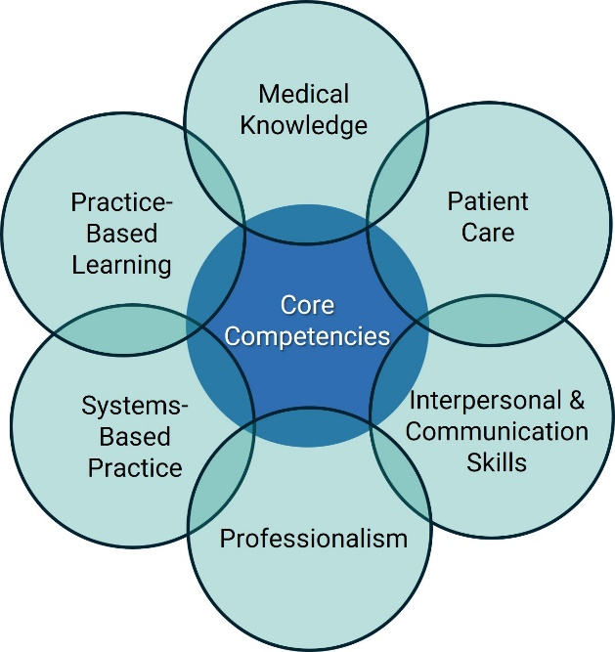


Medical Staff Reappointments
All references are not equal – be sure they are appropriate peer references (i.e., hold the same privileges)
Ensure reference forms include ACGME area of competency
  Ask specific questions
  Ask for review of currently granted privileges
Remember – you are looking for data related to competency. A reference describing a provider as “nice” is….nice, but provides no insight into clinical competence
*
Peer Evaluations / References
OPPE

Slide 9


F/OPPE & Credentialing / Reappointments
Negligent Credentialing
If the organization knew or should have known that a practitioner is not qualified and the practitioner injures a patient through an act of negligence, the organization can be found separately liable for the negligent credentialing of this practitioner.

Slide 10

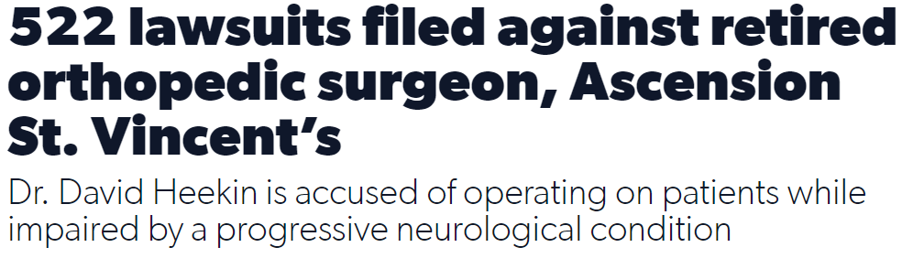
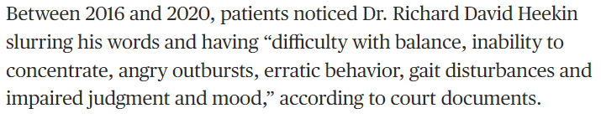
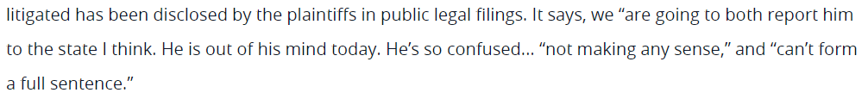
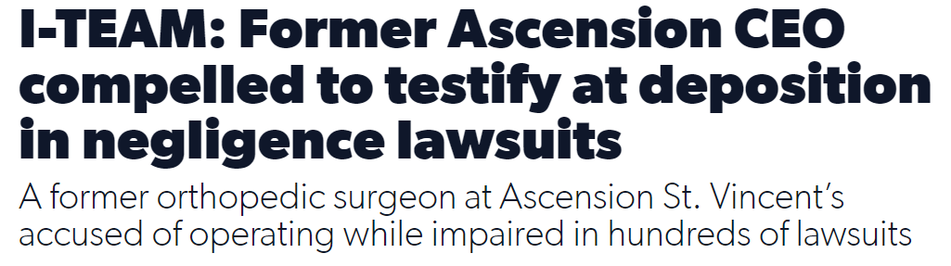
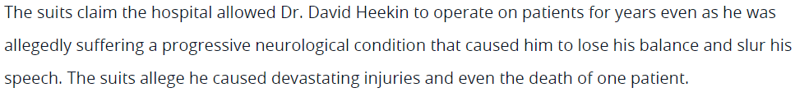
F/OPPE & Credentialing / Reappointments
Negligent Credentialing
2022
License surrendered 2021

Slide 11
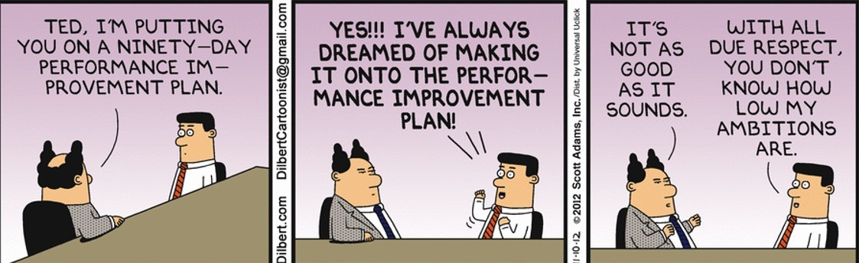
Low/No Volume Providers
F / OPPE Data Challenges

Slide 12

Determination of Competency
“Life Cycle of Credentialing”
FPPE
…etc
OPPE
Low / No Volume Providers
OPPE
Re-Credentialing
Peer
OPPE
OPPE
Peer
Re-Credentialing
OPPE
OPPE
FPPE
Peer

Slide 13

Low / No Volume Providers
Low & No Volume providers create significant quality monitoring and credentialing challenges for most medical staffs
Where do you find data?
What data should be tracked?
How can we grant privileges without adequate PPE and Quality Data?
Does this increase exposure for negligent credentialing?

Slide 14

Meet Low / No Volume Dr. Neo
Dr. Neo is a residency and fellowship trained surgical specialist who has been in practice elsewhere for 5 years and has now applied for privileges at your hospital
Dr. Neo’s practice is almost exclusively outpatient, and your CEO is salivating at the prospect that he will be brining cases to the hospital-owned outpatient surgery center
Dr. Neo’s application was approved by Credentials Committee, the MEC, and the Hospital Board
Great! Now what metrics will be used for his initial FPPE, and how do you monitor them?

Slide 15

Recognize Low/No Volume Drivers
Increase in hospitalist programs
Ambulatory surgery centers expanding services
Increased utilization of Endoscopy Suites
Expansion of minimally invasive procedures being performed in outpatient settings
Financial incentives – Specialist ownership stakes in outpatient settings, ASCs, endoscopy suites, cardiac cath labs….
Increasing number of providers (often women) pursuing work/life balance and time for family
Many providers hold on to privileges because of previous reimbursement requirements – which may no longer be relevant
  There still are 3rd party payers that still require physicians maintain hospital medical staff membership to participate in their network

Slide 16

Understanding the “need”
Why does a provider need hospital privileges?
Staff membership / privileges may be a requirement from third party payer(s)
  Membership alone, without privileges, may meet this requirement
Perception
  They have always had privileges; removing “active privileges” may be seen as a punishment or viewed negatively
Having a conversation is important --- provide understanding regarding the differences between hospital staff membership & hospital privileges

Slide 17



Understanding your “need”
What’s the big deal, and why is it my problem?
Accreditation bodies have raised the bar regarding the need to link privileges with demonstrated current competence
A threadbare “credentials file” is not sufficient
PPE and Quality Data are required to demonstrate competency……
  ….and must be used in the recredentialing process
FPPE is time-limited
& cannot go on indefinitely

Slide 18
Understanding your “need”
What’s the big deal, and why is it my problem?
Low & No Volume providers by definition do not provide enough hospital-based care to demonstrate evidence of competence
Medical staff leaders and MSPs responsible for credentialing / recredentialing need a little creativity and flexibility to identify data sources for these providers
Creativity and flexibility can also help solve this issue for providers who don’t truly require full hospital privileges

Slide 19

Meet Their Needs
&
Satisfy Your Needs

Slide 20
Distinguish between medical staff membership and medical staff privileges
Separate privileges from medical staff membership
Most commonly, active medical staff members are eligible to vote, sit on committees, and hold an office
  An important point of discussion with this option
Privileges delineate what care a provider can deliver to patients in the hospital. Providers must demonstrate their clinical competence to perform granted privileges
Many hospitals have a “Refer & Follow” privilege category
  Allows a provider to visit or see a patient in the hospital, but not to provide care
Expand Medical Staff Membership Definitions

Slide 21
Distinguish between medical staff membership and medical staff privileges
“Refer & Follow” Privileges
Example
Primary care physician in the community has a good relationship with the hospital. She refers patients from her practice to hospital for inpatient care, surgery, etc.
The primary care provider is an active member of the medical staff but does not care for patients in the hospital.
If a patient from her practice is admitted, they are cared for by the hospitalist service.
The PCP may visit the patient in the hospital, view the chart and talk with the hospitalist or other providers about patient’s course of care.

Slide 22

Distinguish between medical staff membership and medical staff privileges
This structure has built a good relationship between the PCP and the hospital, with the providers practicing within the hospital, and elevates the level of care provided to the patient as the PCP is well informed about the continuum of care and prepared to continue care after discharge.
“Refer & Follow” Privileges
Example

Slide 23

Podiatrist with hospital privileges for 25 years is due for reappointment. Has maintained privileges despite rarely setting foot in the hospital…..Why?
  What is his perspective?
  What might require him to provide care in the hospital?
Wanted the option to see his patients if they were admitted…but agreed he would not be providing care.
Had always had privileges, and never considered another option….
“Meeting the Need” Example

Slide 24


Solution : Affiliate Staff Membership / “refer & follow”
  Winding down his practice
  No need or desire for political rights & responsibilities of full staff privileges
“Meeting the Need” Example

Slide 25

Low / No Volume Providers
Maintain good relationships
It’s important to maintain good relationships with providers in the community – they are a crucial referral source
Provide them with opportunities to “stay involved” with the hospital
Establish & maintain good lines of communication with hospitalists and hospital based specialists
Provide education / CME opportunities
Consider varying levels of hospital staff membership & privileges
Maintaining engagement is a critical part of medical staff planning and development

Slide 26

Remember: PPE must be performed on all privileged providers
Understanding Low / No Volume Providers’ needs can permit removing them from PPE requirements…and simplify your life
Requires appropriate bylaws to define these categories
Are all of your privileged providers currently in the correct category?

Slide 27


“Yeah, not really”
“I’m good, right? That takes care of all of the issues?”

Slide 28
Low Volume Providers
Potential datapoints for low volume providers (FPPE & OPPE)
  Patient complaints
  Adverse outcomes / near misses reported by staff
  Outlier performance on core measures
  Data from a sister facility
  Billing data from physician’s office
  Appropriate peer references at time of recredentialing
  Random chart sample reviews
F / OPPE

Slide 29
Low Volume Providers
Potential datapoints for low volume providers (FPPE & OPPE)
  If available, gather OPPE from Group or Sister facility
  Request “Letter of Good Standing” from non-affiliated facility where the provider has privileges
  Ensure your OPPE policy is clear
    Provider must supply current competency and quality data to renew privileges
    It is the provider’s responsibility to ensure this data is available
F / OPPE

Slide 30
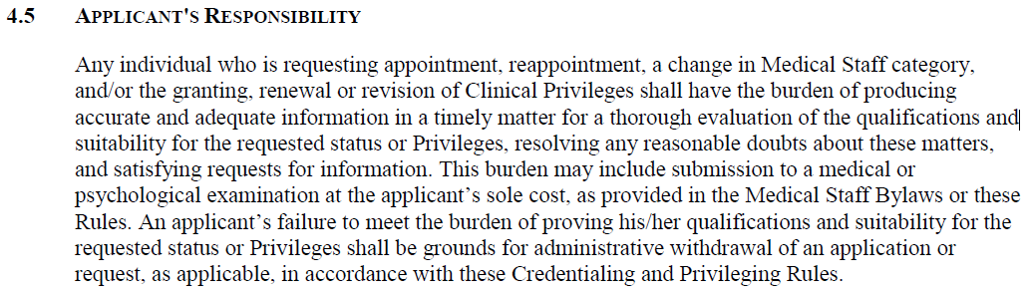
Low Volume Providers
F / OPPE

Slide 31
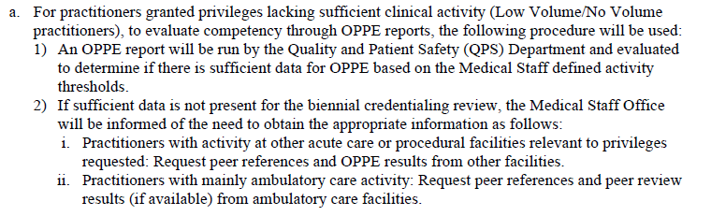
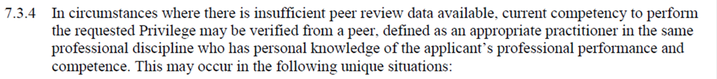
Low Volume Providers
F / OPPE

Slide 32
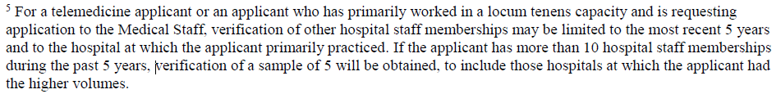
Low Volume Providers – Telemedicine & Locums
If you don’t have a policy, develop one
  Gather OPPE data from a sampling of the facilities where the physician has provided care in the recent past
  This is the applicant’s responsibility
    The contract with the telemedicine or locums provider should include language to ensure this is as easy and seamless as possible
F / OPPE

Slide 33
Low Volume Provider OPPE Use
Table 2
Practice Setting | Information Requested | Impact on Eligibility for Privileges
Active inpatient practice with sufficient quality data at one or more other inpatient institutions | Peer review results at other inpatient institutions and professional references | Independent inpatient privileges within the scope of recent practice
Active ambulatory facility-based practice (e.g., ASC, endoscope suite), but with little or no inpatient activity | Peer review results at ambulatory facilities and professional references | Independent inpatient privileges within the scope of recent ambulatory practice/co-management for other requested privileges pending additional data
Active outpatient practice (e.g., physician office or clinic) but with little or no inpatient activity | Professional references | Independent inpatient privileges within the scope of ambulatory practice/co-management or dependent privileges for other requested privileges pending additional data
Active practice not primarily based in the local community, but which provides necessary clinical services (e.g., locum tenens or telemedicine) | Peer review results at other inpatient institutions and /or professional references | Independent inpatient privileges within the scope of recent practice/co-management or dependent privileges for other requested privileges pending additional data
Restricted inpatient practice at all institutions (e.g., orthopedist requesting only hand privileges or physicians reducing their workload and intensity of practice) | Peer review results at CRH and other inpatient institutions and/or professional references | Independent inpatient privileges with the scope of recent practice/co-management or dependent privileges for other requested privileges pending additional data
Little or no recent clinical practice due to time off and who wish to return to practice (e.g., and OB/GYN returning to practice after taking several years to raise children) | Professional references from previous practice settings | Co-management or dependent privileges for all privileges pending additional data
Clinically inactive practitioners who only seek to continue their affiliation as a member of the medical staff | N/A | Ineligible for privileges
Source: Cindy Rohde, CPMSM and HCPro, 2014 edition of “The Top 45 Medical Staff Policies and Procedures”

Slide 34

F / OPPE Data for Low Volume APPs

Slide 35
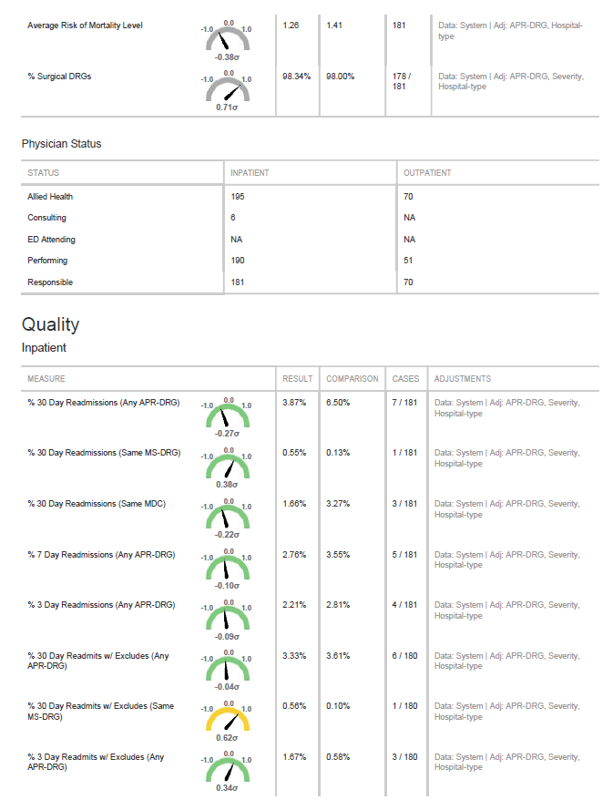
Low Volume Providers
OPPE assessment for Low Volume APPs
Attribution of care can be tricky
Input from supervising physicians is crucial
How to document assessment and monitoring data?

Slide 36
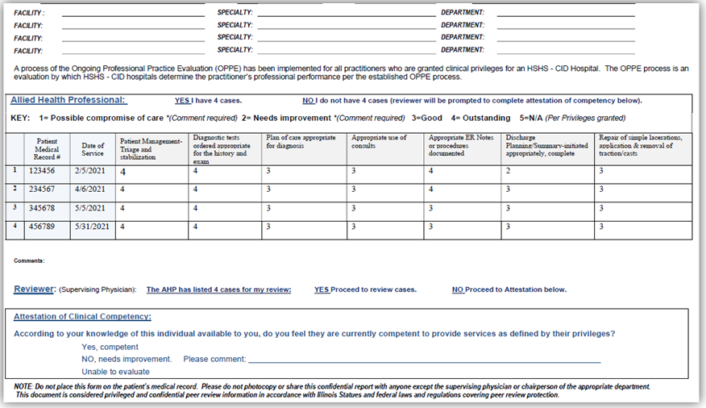
Low Volume Providers
OPPE assessment for Low Volume APPs

Slide 37
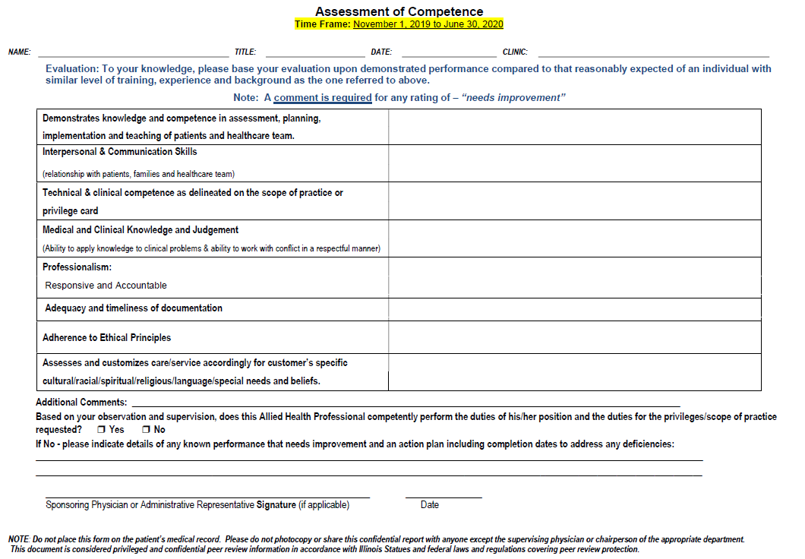
Low Volume Providers
OPPE assessment for Low Volume APPs

Slide 39


Low Volume Providers - Caution
If the organization knew or should have known that a practitioner is not qualified (due to training, quality, or cognitive deficits) and the practitioner injures a patient through an act of negligence, the organization can be found separately liable for the negligent credentialing of this practitioner.
~
The difficulties associated with monitoring low volume providers will not be taken
into consideration in a courtroom setting.

Slide 40


The Late Career, Low Volume Physician
Do any of these scenarios sound familiar?
A late-career primary care physician still wants to manage ICU patients but fails to utilize the resources of critical care physicians and underestimates the severity of his patient’s illness — and an avoidable poor outcome follows.
An older urologist with waning dexterity perforates a patient’s bladder during a routine cystoscopy – maybe more than once!
A general surgeon with a pristine 40-year track record nicks a patient’s common bile duct in 50% of his most recent laparoscopic cholecystectomies.
Knowledge, Skill, or Cognitive Deficit?

Slide 41





The Late Career, Low Volume Physician
Practice Performance Data Ensures Context, Perspective, Fairness, & Patient Safety
Patient Complaints or Staff Concerns?
Outlier on Core Measures?
Medication errors?
Peer References?
Are there other concerns?

Slide 42

Peer Review
Peer Review Should Be:
Responsive
Non-Punitive
Educational
Collegial
Complimentary of Care When Appropriate
Putting the pieces into motion

Slide 43
Historical Peer Review
Medical Executive Committee
Emerg. Medicine Peer
Surgery Peer
Medicine Peer
OB/GYN Peer
Pediatrics Peer
Ortho Peer
Independent Peer Reviews reporting to MEC
Heavily case review-driven process
Lack of coordination of process improvement opportunities
Heavy use of limited Medical Staff resources
Perception of unfairness / conflict of interest
Not terribly efficient
Viewed as punitive, rather than helpful & educational

Slide 44
Contemporary Peer Review
Medical Executive Committee
Emerg. Medicine Peer
Surgery Peer
Medicine Peer
OB/GYN Peer
Pediatrics Peer
Ortho Peer
Multidisc Peer Review Committee
Emerg. Medicine
Surgery
Medicine
OB/GYN
Pediatrics
Ortho
Subject Matter Experts
Medical Executive Committee
Addresses concerns of efficiency, consistency, and fairness
Encourages utilization of aggregate data (OPPE, indicators)

Slide 45
PEER REVIEW COMMITTEE
The Peer Review Committee is responsible for:
Identification of data to be measured
Assuring appropriate collection of data
Assessing the data collected
Making conclusions related to their findings and assessment
Carrying out the peer review function
Reporting findings for inclusion in an individual practitioner profile to be used for the purposes of credentialing and related activities when asked → OPPE, FPPE, Individual case concerns
Reporting findings and conclusions to the Medical Executive Committee. The Medical Executive Committee is responsible for action or recommendations for action based upon the findings and conclusions of the medical staff Peer Review Committee initiatives
Multidisciplinary Peer Review Committee
Bottom line –
Peer Review involves a lot more than reviewing cases

Slide 46
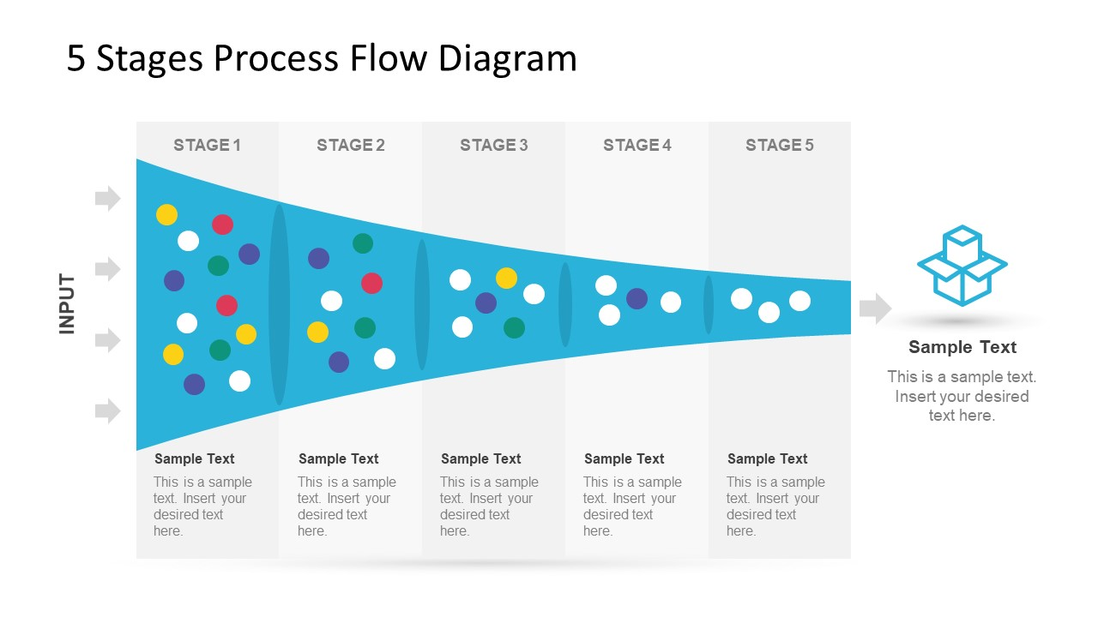
Contemporary Peer Review Stages
1st Stage – Initiation of PR Process
Starts with Triggers:
  Referrals
  Indicators
    Rule-based
    Rate-based
Attribution of care can be challenging
  Straightforward for procedural care
  Aggregate data and complex care can be more problematic
  Be wary of complaints that cannot be validated but observe their frequency.

Slide 47
Contemporary Peer Review Stages
2nd Stage – Screening
Quality Department prescreens with the Chair
  A Minor Rule Violation (simple), or
  A Significant Quality Event (complex)
  Keep track of those that don’t get referred to Peer Review Committee (“Track & Trend”)
  Note: Be diligent at determining whether an event is a minor violation of the medical staff rule or a complex quality event.
OPPE

Slide 48
Contemporary Peer Review Stages
3rd Stage – Multidisciplinary Committee
All significant quality concerns /complex events will be referred to the MD Peer Review Committee
The MD PRC will categorize the event
If no changes in privileges are recommended and no sanctions – the event is “Tracked and Trended”
Note: Once a score is rendered, (as long as there is no recommendation for sanctions) the score given by the MD committee will be final
“Predictable outcome within accepted standards of care”
“There was Opportunity for Improvement”
“Significant Variance from accepted standards of care rendered to this patient”
OPPE

Slide 49
Contemporary Peer Review Stages
3rd Stage – MD PRC Considerations
Should a summary report to the MD Peer Review Committee regarding the cases that were scored as be minor be presented?
Should the physician who reviews the chart contact the physician under review to get all of the facts, prior to scoring the chart?
When should a letter be sent to a physician if a response is anticipated to be required?
  Best Practice – request a response in writing from the physician under review if there are questions or concerns before a final rating, but do not let this delay the process
  Appearance in person….
*

Slide 50
Contemporary Peer Review Stages
3rd Stage – MD PRC Decision Options
No further action or review
Educational/Informational letter
Collegial intervention
FPPE plan
  CME/additional education
  Monitoring/review of set number of cases
  Proctoring
  Referral to formal evaluation & assessment program
  Additional training
Referral to Medical Executive Committee

Slide 51
Contemporary Peer Review Stages
4th Stage – Management of Sanctions
Potential Sanctions
“Triggered” Focused Practice Review (FPPE)
------
Restriction of Certain Privileges
------
Proctoring
------
Chart Review / Monitoring Clinical Practice Patterns
------
Temporary Suspension of Privileges
------
Revocation of Privileges
If any sanctions or changes in privileges are recommended, the issue will be forwarded to the MEC
MEC will either support recommendation, ask for further review or disagree with the recommendation
If MEC supports a significant sanction, the Appeals Process & Fair Hearing Plans are initiated
Ultimately the Board (Governing Body) makes the final determination on sanctions

Slide 52
Contemporary Peer Review Stages
4th Stage – Additional Actions
Exemplary care, regardless of the patient’s outcome, should be formally recognized
Educational
(Redirection)
Not Punitive
Separate documentation concerns from care concerns
Systems / process issues identified should generate communication with administration
Who should participate in Peer Review? Information Sharing?
*
The appropriate Department Chair should be informed of any care / documentation concerns

Slide 53
F/OPPE Information Flow
    FPPE and OPPE require effective communication & collaboration between:
  Medical Staff
  Quality Department
  Medical Staff leaders/Department Chairs/CMO
  Risk management
  MSPs - Credentialing/Privileging
  Nursing Leadership
Peer Review / Professional Practice Committee
Department Chair
Provider
Credentials Committee
Medical Executive Committee

Slide 54

Complementary, Hand-in-Glove Roles
Quality of Care Oversight
Peer Review Committee
Credentials Committee
Med Staff Depts
Credentials Committee ensures that prospective and current medical staff members meet the hospital’s standards for appointment and reappointment
  Initial FPPE
  OPPE
  Incorporation of Peer Review data
Medical Staff Departments are crucial in developing
  Specialty-specific indicators
  Appropriate OPPE and initial FPPE criteria
Peer Review Committee provides input to
  MEC
  Credentials Committee
  Feedback to Departments
Peer review, FPPE, and OPPE data must be utilized in staff recredentialing --- it cannot just be a paper process
?
*
Medical Executive Committee
*

Slide 55

Consistent Method of Communicating Findings
How are results shared with providers?
  Opportunities for improvement
  Commendations – Positive Feedback is Underutilized
  Appropriateness of Care
Have any opportunities for improvement have been identified?
  Process improvements
  Quality of care concerns
  Communication /documentation deficiencies
  Behavioral/Professional concerns
F / OPPE
&
Peer Review
Celebrate great
performance in public.
Remediate deficient
performance in private.

Slide 56

Disruptive Providers
Disruptive behavior and its potential for causing patient harm are closely linked
When there appears to have been a significant behavioral component in a case under review, it is the Peer Review Committee’s responsibility to break that link to allow care evaluation to be undertaken independently
Create a separate pathway for evaluating and adjudicating possible behavioral problems
  Professionalism / Citizenship Committee – include APPs
  CMO & CNO as non-voting members
Peer Review
Considerations
Maintains Peer Review Protections
“Triggered” FPPE is an excellent tool in this scenario

Slide 57
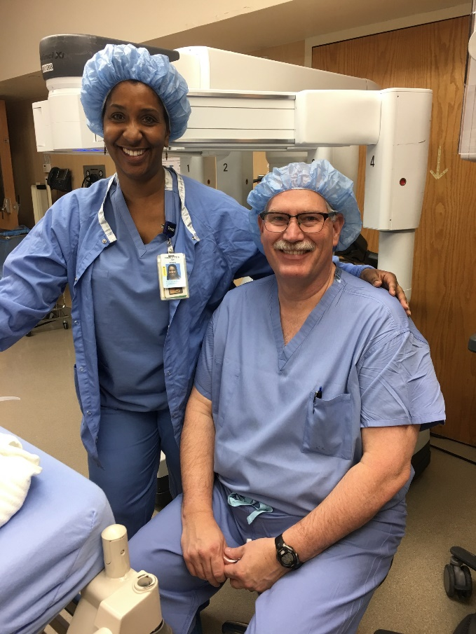
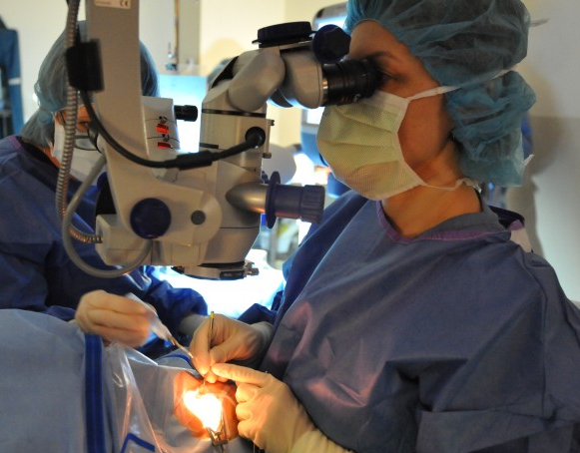
Credentialing & Peer Review Scenarios
Scenario 1
  “Later career” general surgeon requests Robotic Surgery privileges
  What are the next steps for the Credentials Committee?
  Review of education, training, etc.
  FPPE for new credentials
  Proctoring
Scenario 2
  Busy ophthalmologist
  OPPE “catches” apparent higher rate of cataract surgery complications
    But volumes are low – majority of procedures are done at an outpatient facility
  What should the Peer Review Committee recommend?
  Any additional data available?
  Track/trend vs “Triggered” FPPE?

Slide 58
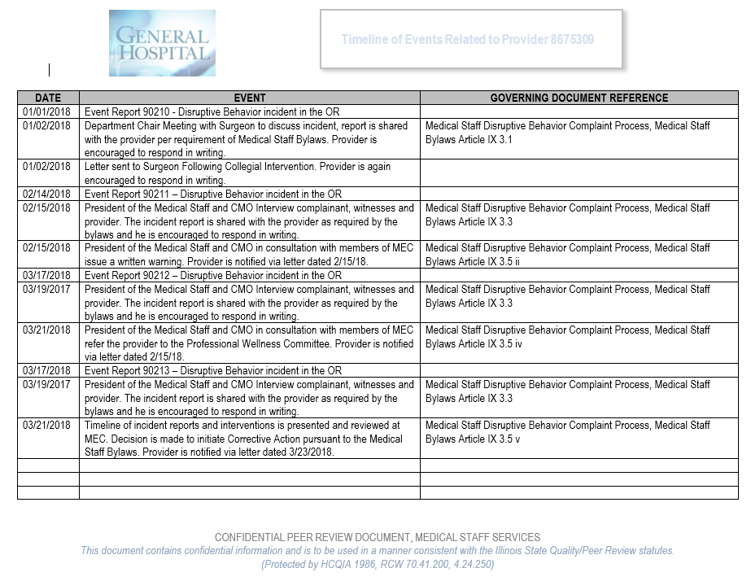

Takeaways
Follow your processes
  F/OPPE cannot just be paper processes
  Robust PPE supports robust Peer Review & Credentialing
If it isn’t documented….it didn’t happen
Help yourself! Use a standardized documentation timeline

Slide 59

GOVERNING BODY (BOARD)
MEDICAL STAFF
Trifurcated Hospital Governance
ADMINIS-TRATION
Physician Leaders
With competing priorities, patient safety can get lost in the shuffle
Partners for Success with
Quality & Patient Safety
CMS Condition of Participation §482.22 - The hospital must have an organized medical staff … which is responsible for the quality of medical care provided to patients by the hospital.
Financial Viability,
Operations, Meet Community Needs

Slide 60
Why Do We Credential, Appropriately Privilege, and Monitor Performance of Physicians & APPs with Peer Review?
It’s all about competency

Slide 61




Slide 62


Let’s Chat!
SCameron@HardenberghGroup.com

Slide 63


What About Non-Hospital Settings?
Single & Multispecialty Clinics, FQHCs
FQHCs
  The health center must have an ongoing quality improvement/assurance (QI/QA) system that includes clinical services and [clinical] management and maintains the confidentiality of patient records.
  The health center has a board-approved policy(ies) that establishes a QI/QA program.1 This QI/QA program addresses the following:
    The quality and utilization of health center services;
    Patient satisfaction and patient grievance processes; and
    Patient safety, including adverse events.
Clinic Settings?
  More difficult, but not impossible
  More flexibility with larger / multispecialty practices
  Best practices
HRSA Health Center Compliance Manual, Chapter 10
https://bphc.hrsa.gov/compliance/compliance-manual/chapter10
Notes:
Understanding what you should be doing to monitor quality, and then tailor your approach to meet that need based upon your setting

Slide 64
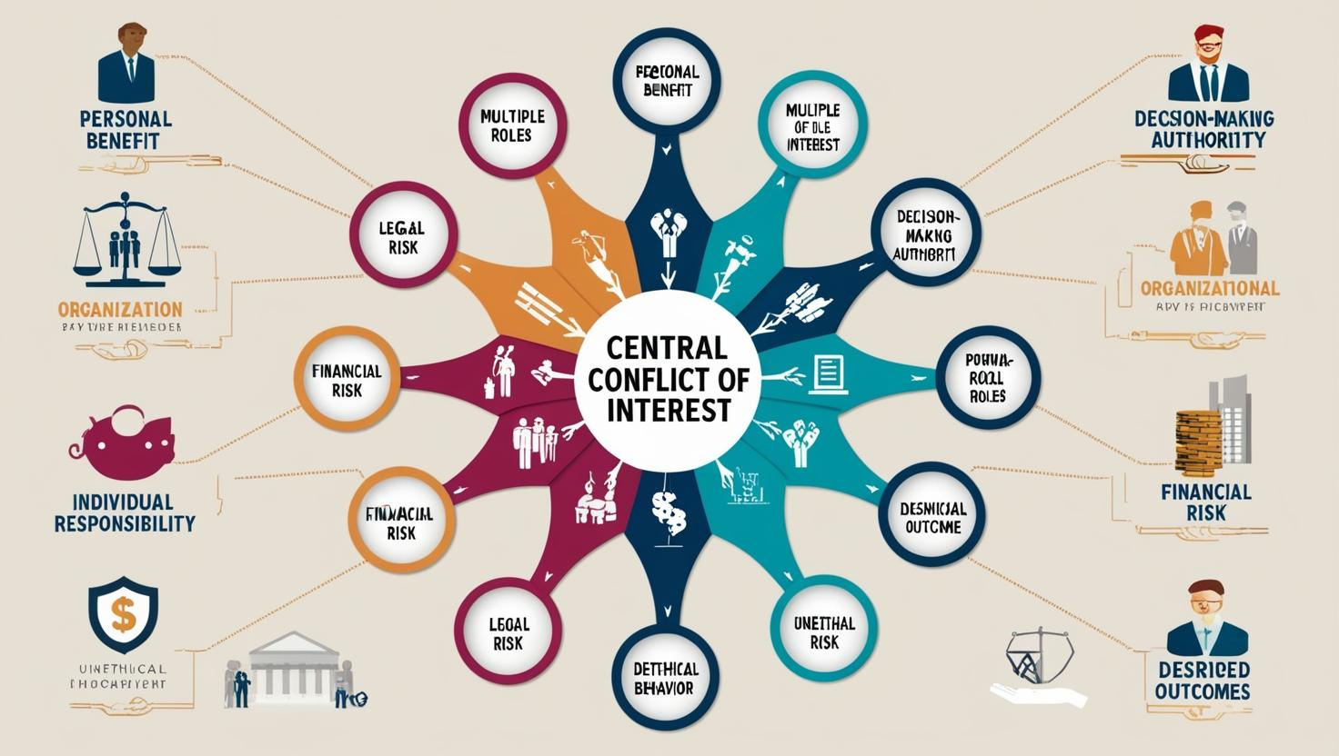
Peer Review in the Outpatient Arena
Challenges
Identifying viable, unbiased reviewers
Developing robust assessment programs
Influence of collegial and business ties which can hamper meaningful evaluations
  Shared clinic ownership
  Be acutely aware of conflicts of interest
Notes:
Shared clinic ownership…..and ASC ownership

Slide 65








Peer Review in the Outpatient Arena
Challenges Solutions
Identify practice-specific, meaningful, and measurable metrics
  Patient satisfaction surveys
  Staff interactions / complaints / compliments
  Adherence to best practice guidelines
  Documentation adequacy
  Survey of referring / referral physicians
Random chart reviews
Identify “triggers” for in-depth focused reviews

Slide 66
Peer Review in the Outpatient Arena
“Trigger” Samples
Unexpected mortality within 48 hours of clinic visit
Unplanned return to clinic within 72 hours with original symptoms
Iatrogenic injury
Moderate to severe adverse medication reactions
Improper consent
Nosocomial infection from procedure performed in clinic
Delay in referral to ED, higher level of care, or specialist consultant
Behavioral concerns
Patient complaints
Documentation concerns
Medication error
Delay in responding to test or ordered procedure results
Critical lab or diagnostic studies not addressed
Excess controlled substance prescribing
Adverse outcome / serious reportable event
Improper / inadequate midlevel provider supervision
Quality of care concern letter from hospital, regulatory agency, or insurance company
Litigation claims

Slide 67

Peer Review in the Outpatient Arena
Challenges Solutions
Develop a standardized process & apply it consistently
Schedule periodic (every 2 years or so) review of the QI and Peer Review processes
Compare individual and organization-wide performance with published guidelines and benchmarks
  Develop improvement plans as indicated
Don’t forget to
  Make it legal
  Ensure confidentiality
  Consider external review when appropriate

Slide 68

Peer Review Scenarios

Slide 69
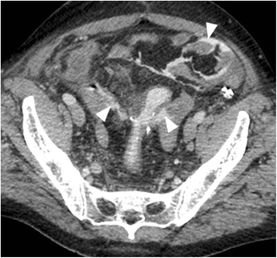
Possible Excess Complication Rate
A general surgeon who has been on staff for one year has had two patient mortalities in the past month following bowel resection with anastomosis.
A review of this physician’s OPPE reveals that this physician is an outlier with anastomotic leaks in comparison to his surgical peers.
Peer Review Scenario #1
Quality of Care Concern

Slide 70
Possible Excess Complication Rate
What Now?
Department Chair Reviews OPPE data and current cases
Is the Department Chair free of any conflict of interest?
Next Steps?
Department Chair refers the concern to the Peer Review Committee
Is the Committee free of any conflict of interest?
Peer Review Scenario #1
Quality of Care Concern

Slide 71
Possible Excess Complication Rate
Next Steps?
The Peer Review Committee must now develop a plan to validate or invalidate the concern.
Peer Review Scenario #1
Quality of Care Concern

Slide 72

Routine utilization of standardized timeline forms assists both Medical Staff Professionals and Peer Review Committee members in remaining organized and aware of the investigation’s progress
Do Yourself A Favor!
Peer Review Scenario #1
Quality of Care Concern

Slide 73
Possible Excess Complication Rate
Pull data!
The Review Design
All Adult patients undergoing a bowel resection with anastomosis for a 24 month period
Patients with a postoperative leak based on standardized criteria were identified
Patient characteristics, surgical procedures, and operating surgeon were noted
Overall complication and leak rates by surgeon were compared using national morbidity and mortality data
Peer Review Scenario #1
Quality of Care Concern

Slide 74
Possible Excess Complication Rate
The Initial Review Process
Once the data was compiled, the Peer Review Committee assigned a small sub-committee to review the data
Individual case reviews by a group of peers was performed for all patients with a leak who died, to determine any potential relationship between the complication and mortality
Peer Review Case Study #1
Quality of Care Concern

Slide 75
Possible Excess Complication Rate
Initial Sub-Group Findings
Sixty-four patients underwent resection with anastomosis during the review period.
Twelve patients experienced leaks (5.3%), four of whom died (most studies put the national leak rate at ~3%)
Leak rate for the highest volume surgeons ranged from 0.6% to 9.1%
Overall complication rates varied from 30.5% to 44%
Of the four mortalities, two occurred in highly morbid patients undergoing emergent procedures with resultant high risks for morbidity and mortality.
Peer Review Case Study #1
Quality of Care Concern

Slide 76
Possible Excess Complication Rate
The two deaths not attributed to co-morbidities were patients of the provider under review --validating this provider as an outlier in his specialty.
Now what?
The committee now has the option to develop a remediation plan. But what will that look like?
Initial Sub-Group Findings
The variability in leak rate by surgeons doing similar operations suggests that some leaks may be preventable.
Critically ill patients with multiple comorbidities were found to have deaths not directly related to an anastomotic leaks.
The two patient deaths experienced by the provider under review did not occur in the setting of high patient morbidity / emergent surgery, with the deaths felt to be due primarily to the leaks.
Peer Review Case Study #1
Quality of Care Concern

Slide 77
Possible Excess Complication Rate
Three key opportunities in this providers cases were identified.
This provider preferred performing an end-to-end (E-E) vs. side-to-end (S-E) anastomosis technique in all his cases
Antibiotic prophylaxis and discontinuation of corticosteroids
Intraoperative air leak test
Initial Sub-Group Findings
The reviewers have gleaned considerable information about all of the surgeons’ care, with both good and poor outcomes
At times, no clear definable etiology of the complications was apparent
The reviewers did identify differences in surgical technique and perioperative care between the surgeon under review and his peers
Peer Review Scenario #1
Quality of Care Concern

Slide 78
Possible Excess Complication Rate
Options Moving Forward
More extensive review with other privileged providers
External Peer Review
Creation of a Remediation Plan
Peer Review Scenario #1
Quality of Care Concern

Slide 79
Possible Excess Complication Rate
To address these identified opportunities the Peer Review Committee developed a “Triggered FPPE” / Voluntary Improvement Plan:
Proctoring by a colorectal surgeon on the Side-to-End anastomosis technique (shown in some studies to lower risk of anastomotic leak)
Incorporation of antibiotic prophylaxis and temporary discontinuation of corticosteroids (when in use) into cases
Addition of intraoperative air leak test into colorectal anastomoses.
Peer Review Scenario #1
Quality of Care Concern
Creation of a Remediation Plan

Slide 80
Possible Excess Complication Rate
To assure provider competency and patient safety the Peer Review Committee kept this provider on a focused review plan for one year.
This included review of all bowel resections with anastomosis performed by this provider during those 12 months.
Peer Review Scenario #1
Quality of Care Concern

Slide 81

Impaired Provider
Background
Young Vascular Surgeon
Joined practice immediately following completion of fellowship
Recruited with the understanding that he would join an established vascular surgery program led by experienced & respected surgeons
Practice setting:
  Acute care hospital
  Level 2 Trauma facility
  250 beds
Peer Review Scenario #2
Impaired Provider

Slide 82
Impaired Provider
Background – Joining Clinical Practice
New surgeon came from a respected training program
Satisfactory reviews from residency coordinator & references
Joined a well-respected group with two senior physicians who were able & interested in mentoring new partner
All three physicians would share the call burden
Peer Review Scenario #2
Impaired Provider

Slide 83

Impaired Provider
Changes to Practice
One senior surgeon abruptly retires soon thereafter
Second senior surgeon is left to mentor the new physician in addition to taking call & running established practice
Some initial clinical concerns are chalked up to “inexperience”
Early collegial discussions with senior surgeon & CMO are met with some defensiveness by the new physician, who feels “he knows what he is doing”
Unfortunately, these discussions are not well documented
Peer Review Scenario #2
Impaired Provider

Slide 84

Impaired Provider
Concerns Evolve
New surgeon’s demeanor discourages potential mentors from providing contemporaneous feedback on intraoperative techniques & decision-making
The remaining senior surgeon notes that the young surgeon seems nervous when other physicians are in the OR watching, proctoring, or attempting to mentor him
A small tremor is observed, but largely ignored
Senior surgeon begins to cut back his practice and soon stops going to the OR with the younger surgeon
And time passes by….
Peer Review Scenario #2
Impaired Provider

Slide 85
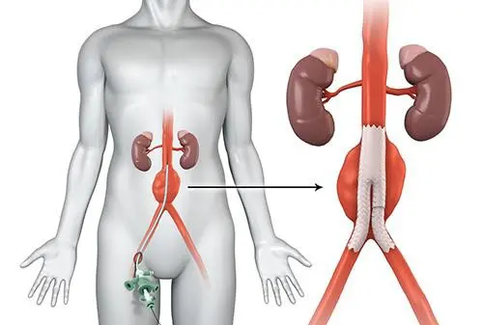
Impaired Provider
Catastrophic Event
60 yo male with a 6.1cm AAA incidentally discovered on a CT scan for trauma
Patient taken to the OR for EVAR (endovascular aortic aneurysm repair with endograft)
Expired from exsanguination six hours postop due to inappropriately placed percutaneous arterial puncture closure device
Concern is raised by surgical PA, nursing, and anesthesiologist involved in the operation
Provider is suspended pending investigation
Peer Review Scenario #2
Impaired Provider

Slide 86
Impaired Provider
Medical Staff Impact & Implications
Lack of documentation and a lack of any action taken in prior years, combined with poor clinical outcomes had a dramatic impact on the medical staff
  Colleagues have lost / lack trust in the physician
  Cardiology & General surgery are hesitant to refer patients
  Anesthesiologists are reluctant to provide coverage for his cases
  Surgical PAs and nursing staff are concerned about patient outcomes and are reluctant to assist in the OR
Peer Review Scenario #2
Impaired Provider

Slide 87
Impaired Provider
Next Steps?
Medical Staff leadership initiates a review of the index case as well as 5 additional cases that were identified as “concerning”
Peer Review Scenario #2
Impaired Provider

Slide 88
Impaired Provider
Initial Review Findings
Internal case reviews identified significant clinical concerns
  Medical / clinical knowledge deficits
  Clinical judgement concerns
  Surgical technique issues
  Observed to “panic” in the OR when complications arose
  Tremor observed by others in the OR
“Burnout” concerns raised
  Physician stressed, over-worked
  On call 24/7, sole vascular surgeon by this time
Peer Review Scenario #2
Impaired Provider

Slide 89
Impaired Provider
Confounding Factors
No well-documented history of concerns that were previously raised and (at least partially) addressed
The hospital does not have a Physician Wellness Committee
Peer Review Scenario #2
Impaired Provider

Slide 90
Impaired Provider
Cases Sent for External Review
Appropriate reviewer selected
    Vascular surgeon, similarly trained
    Unbiased with no conflict of interest
Case selection for review – index case plus 10 additional randomly selected cases
Findings – external review identified similar, significant concerns
    Medical / clinical knowledge deficits
    Clinical judgement concerns
    Surgical technique issues
Peer Review Scenario #2
Impaired Provider

Slide 91
Impaired Provider
Next Steps?
Medical Staff leadership mandates a full mental & physical evaluation of the physician through the state Physician Health Program
A physical condition is identified – tremor
Tremor is noted to be “worsened under stressful conditions”
Peer Review Scenario #2
Impaired Provider

Slide 92
Impaired Provider
Conclusion
Physician’s surgical privileges were revoked
Hospital pursues development of a physician wellness committee
  Burnout & stress issues may have been better addressed by a wellness committee, separately from peer review concerns
Opportunity for improvement identified in medical staff processes and documentation of those processes
*
Peer Review Scenario #2
Impaired Provider

Slide 94

Let’s Chat!
SCameron@HardenberghGroup.com

